Slide 1
The Existence of God
Part 2: Pascal’s Wager, Innate Desire Argument, Transcendental Argument
By Stephen Curto
For Homegroup
November 4, 2018

Slide 2
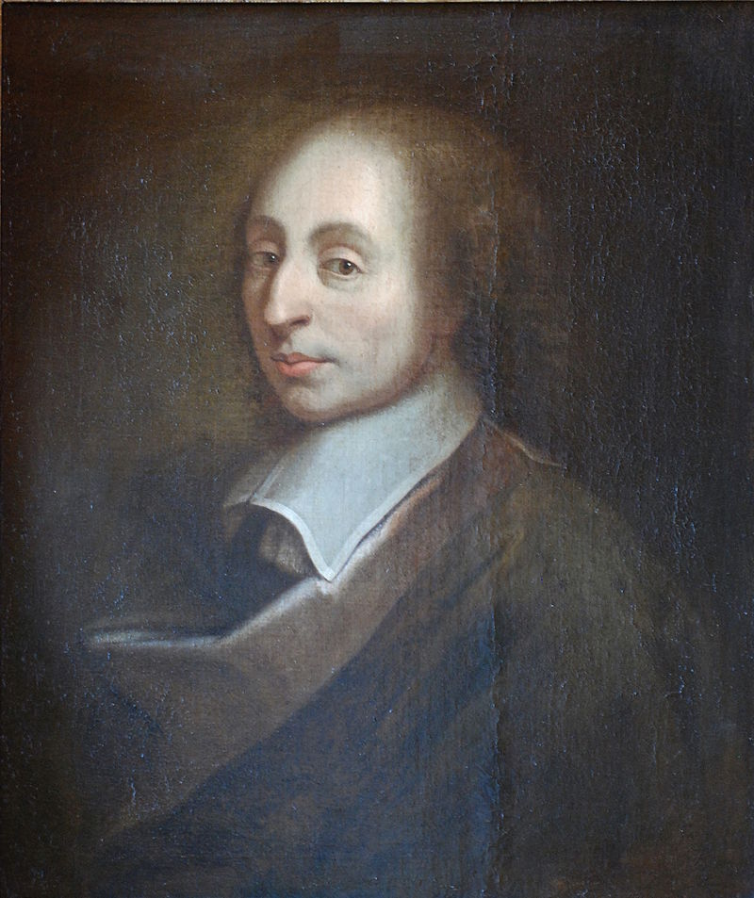
Pascal’s Wager
Blaise Pascal
Philosopher, Mathematician, Physicist
1623-1662
Pensées
Wrote treatise on Projective Geometry at age 16
Help invent calculators

Slide 3
Pascal’s Wager
The Wager (excerpts from Pensées, part III, §233):
God is, or God is not. Reason cannot decide between the two alternatives.
A Game is being played... where heads or tails will turn up.
You must wager (it is not optional).
Let us weigh the gain and the loss in wagering that God is. Let us estimate these two chances. If you gain, you gain all; if you lose, you lose nothing.
Wager, then, without hesitation that He is. (...) There is here an infinity of an infinitely happy life to gain, a chance of gain against a finite number of chances of loss, and what you stake is finite. And so our proposition is of infinite force, when there is the finite to stake in a game where there are equal risks of gain and of loss, and the infinite to gain.
But some cannot believe. They should then 'at least learn your inability to believe...' and 'Endeavour then to convince' themselves.

Slide 4
Pascal’s Wager
The Wager (restated):
God either exists or he does not.
One wagers with his life on one or the other.
If God exists, infinite happiness awaits after death for those who wager with Him, and infinite pain for those who wager against.
If God does not exist, nothing awaits after death either those wagering for or against.
The relative cost to wagering with God, to the payoff received makes it foolhardy to wager any other way.

Slide 5
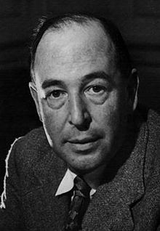
Innate Desire Argument
C.S. Lewis
Professor of literature, Philosopher, Author
Wrote over 30 books
Professor at Oxford and Cambridge
Argument:
There are no desires common to humans for which satisfaction for that desire does not exist, therefore the desire for God and final justice suggest the existence of God and final justice.
Notes:
“Creatures are not born with desires unless satisfaction for those desires exists. A baby feels hunger well, there is such a thing as food. A duckling wants to swim: well, there is such a thing as water. Men feel sexual desire: well, there is such a thing as sex. If I find in myself a desire which no experience in this world can satisfy, the most probable explanation is that I was made for another world. If none of my earthly pleasures satisfy it, that does not prove that the universe is a fraud. Probably earthly pleasures were never meant to satisfy it, but only to arouse it, to suggest the real thing. If that is so, I must take care, on the one hand, never to despise, or be unthankful for, these earthly blessings, and on the other, never to mistake them for the something else of which they are only a kind of copy, or echo, or mirage.
I must keep alive in myself the desire for my true country, which I shall not find till after death; I must never let it get snowed under or turned aside; I must make it the main object of life to press on to that other country and to help others to do the same.” – C.S. Lewis Mere Christianity

Slide 6
Transcendental Argument
The Argument:
God is a necessary precondition for logic and morality (because these are immaterial, yet real universals).
People depend upon logic and morality, showing that they depend upon the universal, immaterial, and abstract realities which could not exist in a materialist universe but presupposes the existence of an immaterial and absolute God.
Therefore, God exists. If He didn't, we could not rely upon logic, reason, morality, and other absolute universals (which are required and assumed to live in this universe, let alone to debate), and could not exist in a materialist universe where there are no absolute standards or an absolute Lawgiver.

Slide 7
Transcendental Argument
The Argument (Simplified):
All truth, knowledge, rationality, meaning, actuality, possibility, and the Bible, presuppose God’s existence.
Therefore, God exists.
Strongest Proponent: Cornelius Van Til

