Slide 1
The Problem of Evil
Part 1: Defining Terms; Addressing the Philosophical Problem; Surveying the Field of Study
By Stephen Curto
For Homegroup
November 4, 2018

Slide 2
Defining Terms
Theodicy
Natural Evil
Willful Evil
Suffering

Slide 3
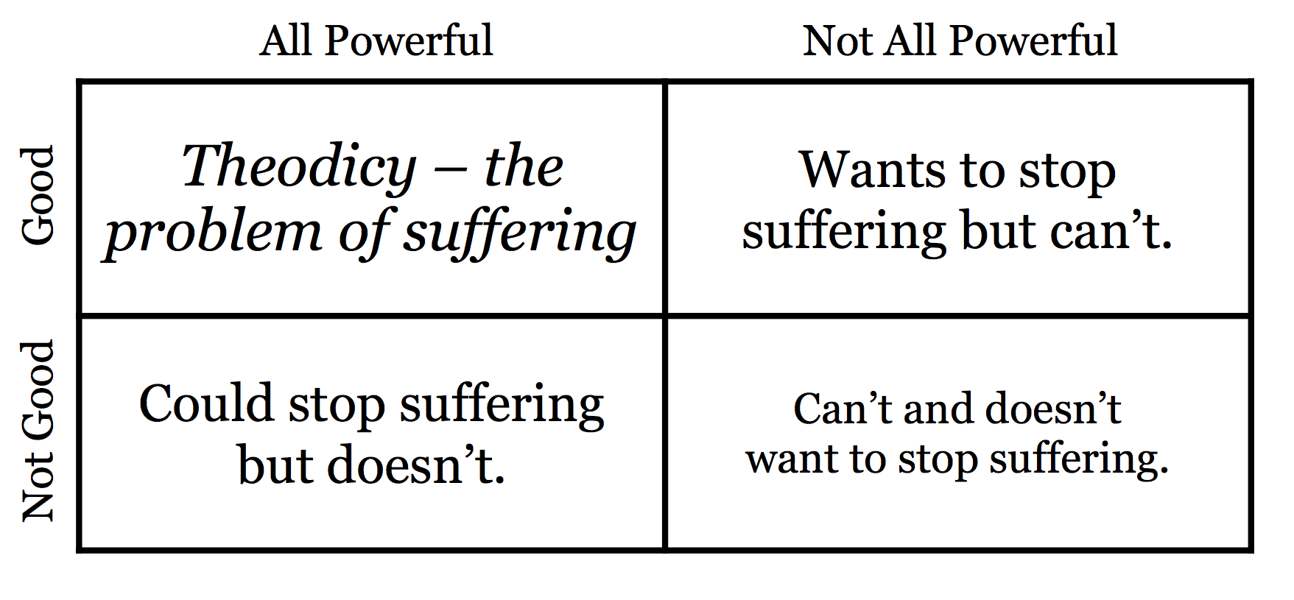
Defining Terms
Theodicy
Generally used to mean “the problem of evil”
Literally: theos – God; dikaios – Righteous
A defense of God’s righteousness in the face of the problem of evil
Natural Evil
Willful Evil
Suffering

Slide 4
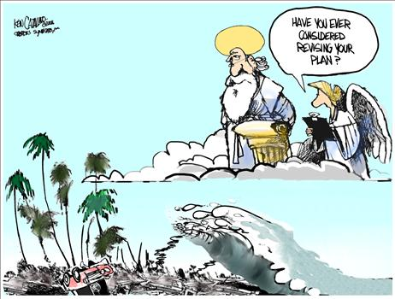
Defining Terms
Theodicy
Natural Evil
Natural disasters (e.g. Hurricanes, Tornados, Earthquakes, etc.)
Natural decay of what is good (Fragility of Age, Rot, etc.)
Willful Evil
Suffering

Slide 5
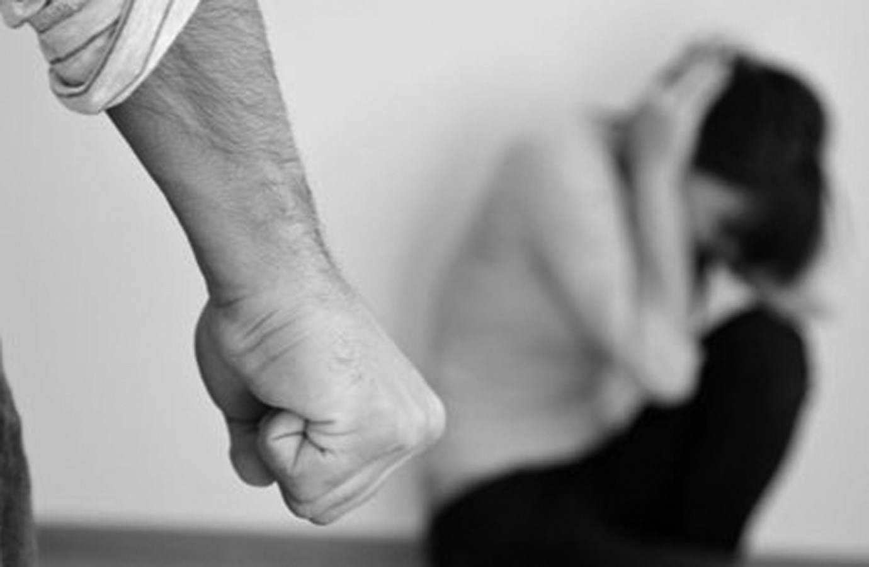
Defining Terms
Theodicy
Natural Evil
Willful Evil
Sinful activity (e.g. rape, murder, greed, etc.)
Suffering

Slide 6
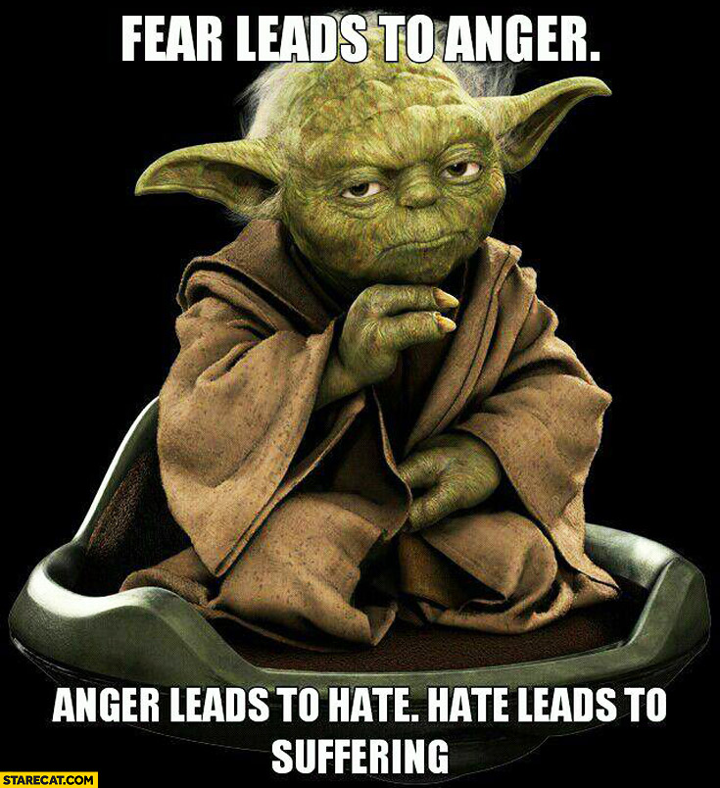
Defining Terms
Theodicy
Natural Evil
Willful Evil
Suffering
That which is uncomfortable, even extremely so, even possibly resulting in death

Slide 7
Addressing the Philosophical Problem
If God is omnipotent (all-powerful) and omnibenevolent (all-good) then evil would not exist.
Evil does exist.
Therefore, God is either not omnipotent, not omnibenevolent, or does not exist at all.

Slide 8
Addressing the Philosophical Problem
Voddie Baucham from the 2006 Desiring God National Conference "The Supremacy of Christ and Truth in a Post Modern World." desiringgod.org
https://youtu.be/vQl4Zd5T9Kc?t=42

Slide 9
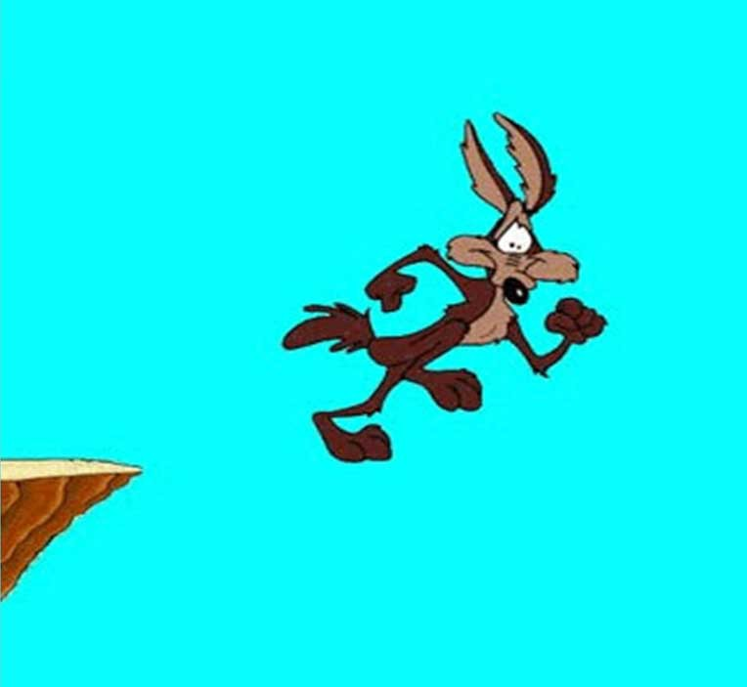
Addressing the Philosophical Problem
The philosophical problem of evil presupposes an undeserved/non-existent ground of good on the part of the philosopher
“Why do bad things happen to good people?”
Properly understanding the the problem is the first step to evaluating solutions

Slide 10
Surveying the Field of Study
The Illusion of Evil Defense
The Best-Possible-World Defense
The Free-Will Defense
The Indirect-Cause Defense
The Ex Lex Defense

