Slide 1
2 Thessalonians
By Stephen Curto
For Homegroup
January 27, 2019

Slide 3
Context
Acts 17-18
Describe the people in Thessalonica. Jews or Gentiles? Friendly or hostile? What happened while he was there?
How long was he there?
Where did Paul come from, to Thessalonica, and where did he go after?
What has happened so far in Acts?

Slide 4
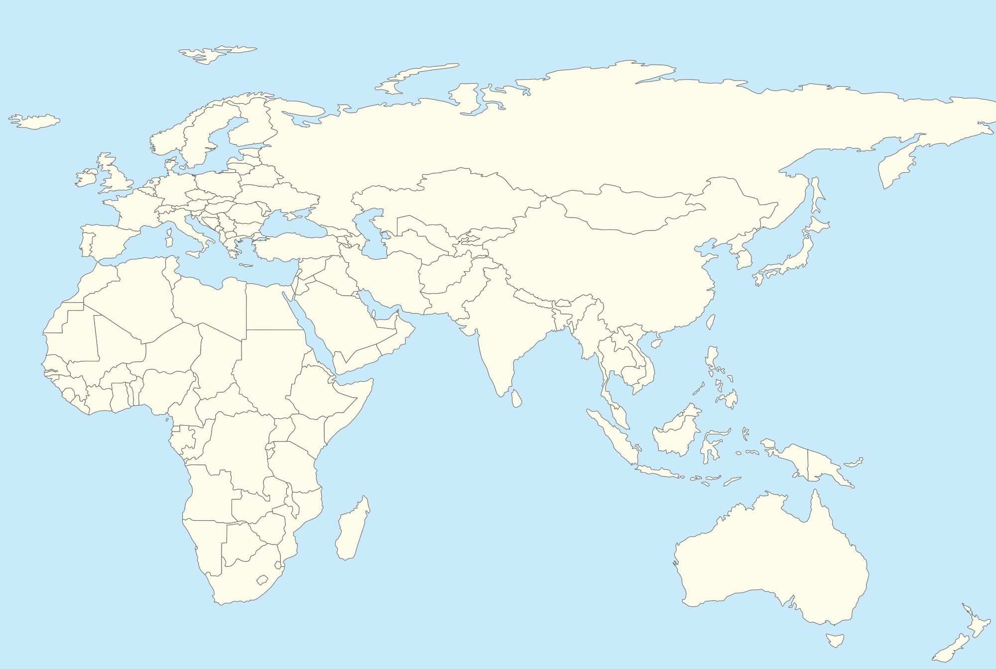

Slide 6
Background Info
Date: Approx 51AD
Audience: Jews and Gentiles in Thessalonica who believe the gospel
Reason for writing: A clarification of Eschatological hope.
Place of writing: Corinth, staying with the Priscilla and Aquilla for a year and a half (near the end of his stay)

Slide 7
Outline
Introduction, Thanks, and Outline (ch 1)
Clarification of Eschatology (ch 2)
Final Warnings and Requests (ch 3)

Slide 8
Introduction, Thanks, and Outline (Ch. 1)
“We owe thanksgiving to God for you, because your faith is greatly enlarged…” (v3)
“Therefore we boast of you…” (v4)
Cf. 1 Thess 2:19ff
What do the apostles boast about?
“It is just for God to repay those who afflict you with affliction…” (v6)
When will this happen? (cf v7)

Slide 9
Introduction, Thanks, and Outline (Ch. 1)
Who will be dealt “retribution” in “flaming fire”? (v8)
“These will pay the penalty of eternal destruction, away from the face of the Lord” (v9)
Who is “these”?
“when he comes to be glorified with his holy ones on that day…” (v10)
What day are we talking about?
Who are “his holy ones”?

Slide 11
RAPTURE (various views)
SECOND COMING
GREAT WHITE THRONE JUDGMENT
PREMILLENNIALISM
7 YEAR TRIBULATION
Literal 1000 year Millennium
Church Age
We are living Here
SECOND COMING & GWTJ
POSTMILLENNIALISM
Millennium (may be 1,000 years prior to Christ’s return, or may be entire period; Church is reforming world to usher in Christ’s return)
ETERNITY
TRIBULATION
We are living Here
SECOND COMING & GWTJ
AMILLENNIALISM
Millennium (not 1,000 literal years)
TRIBULATION
We are living Here
Not all Amillennialists believe the tribulation has already happened in AD 70. Some would put it just before the 2nd Coming.

Slide 12
Introduction, Thanks, and Outline (Ch. 1)
“…and be marveled at among all who have believed because our testimony to you was believed.” (v10)
Based on this sentence, why will people believe at Christ’s return?
What do the apostles pray for the Thessalonians?
(v11-12)

Slide 13
Clarification of Eschatology (Ch. 2)
”We request that, regarding the coming of our Lord Jesus and our gathering together to Him, that you not be quickly shaken… to the effect that the day of the Lord has come.” (v2)
What is the request in simpler words?
”Let no one deceive you, for unless the apostasy comes first, and the man of lawlessness is revealed…” (v3)
Who is the man of Lawlessness and what will he do?

Slide 14
The Man of Lawlessness:
aka: “Son of destruction” (2:3)
Oppose and exalts himself above every ”god” (2:4)
Takes his seat in the temple of God (2:4)
By so doing, declaring himself as God (2:4)
“currently” (in Paul’s time at least) being “restrained” from being revealed (2:7)

Slide 15
The Man of Lawlessness:
Will be slain with the “breath” of the Lord’s mouth (2:8)
Will be destroyed with the same brightness of his coming (2:8)
Cf. Dan 9:26-27; Rev 13; Mark 13:14

Slide 16
Clarification of Eschatology (Ch. 2)
“And now you know about the restraining, so that he will be revealed in his own time. For the mystery already is working from lawlessness, only the one restraining now, until from amidst he come.” - 2:6-7 Stephen’s translation
Who is this “one restraining”
The Holy Spirit (cf. Gen 6:3)
Angel Michael (cf. Daniel 12:1)
The Jewish State
The Roman Empire

Slide 17
Clarification of Eschatology (Ch. 2)
”For this reason…” (v11)
For what reason? (cf. v10)
“…God will send upon them a work of deceit so that they will the false (wonders).” (v11)
How does your theology account for this verse?
“… in order that they all may be judged who did not believe the truth but took pleasure in wickedness.” (v12)

Slide 18
Facts about the coming of the DotL:
Apostasy comes first (2:3)
Man of lawlessness is revealed (2:3)
He who restrains Man of Lawlessness is removed (2:7)
Man of Lawlessness will appear with false signs and wonders (2:9)
Those who believe the false signs will die/be judged/not be saved (2:10-12)

Slide 19
Has this already happened?
Preterist answer: Yes. (man of lawlessness is usually interpreted as either Titus, or Vespasian, or Nero)
Dispensational answer: No. We are still awaiting the revealing of the man of lawlessness.
Charismatic answer: Yes and no. The Man of lawlessness is not a single man, but the evil satanic forces working against the church today.

Slide 20
Clarification of Eschatology (Ch. 2)
“God has chosen you from the beginning for salvation in holiness of the Spirit and faith of the truth.” (v13)
How do you account for this verse in your theology?
“It was for this he called you through our gospel” (v14)
It was for what he called who?
Through who’s gospel?
How did God call them?

Slide 21
Clarification of Eschatology (Ch. 2)
“hold to the traditions you were taught” (v15)
What traditions were they taught? (cf. 2:5; 1 Thess)
“May our Lord Jesus Christ Himself… encourage and strengthen your hearts in every good work and word.” (v17)

Slide 22
Final Warnings and Requests (Ch. 3)
“Pray for us that the word of the Lord might run and be glorified as it did with you” (v1)
What is “the word of the Lord”?
“We have confidence… that you are doing and will do what we command.” (v4)
Who is Paul talking to?
“Now we command you… keep away from every brother living irresponsibly, and not according to the tradition you received from us.” (v6)
Are we to follow this instruction?

Slide 23
Final Warnings and Requests (Ch. 3)
“We did not act irresponsibly with you, or eat bread without paying for it… but worked… so that we would not be a burden to any of you” (v8)
“Not because we do not have the right” (v9)
Who and what right is being referenced here?
“If anyone does not wish to work, he must not eat.” (v10)
Is this instruction for us to follow?

Slide 24
Final Warnings and Requests (Ch. 3)
Why does Paul give these instructions about responsibility? (cf v11-12)
”If anyone does not obey our instruction in this letter, take note… and do not associate with him, that he will be shamed, but do not regard him as an enemy but admonish him as a brother.” (v15)

