Slide 1
The Unity of the Scripture: One Continuous Story
By Stephen Curto
For C3 YAM Word Study
February 23, 2019

Slide 2
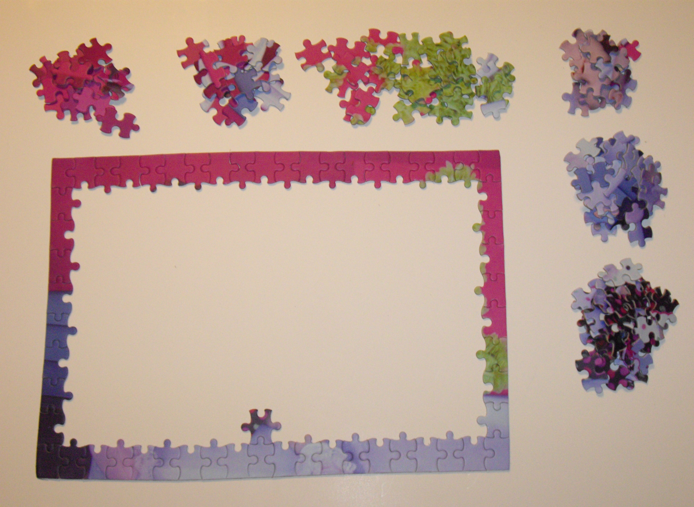

Slide 3
How To Read a Book
Green Eggs and Ham
The Story of the Bible

Slide 4
How To Read a Book
Green Eggs and Ham
Characters:
Conflict:
Rising Action:
Climax:
Resolution:
The Story of the Bible

Slide 5
How To Read a Book
Green Eggs and Ham
Characters: “I” and “Sam”
Conflict: “I” doesn’t like Sam.
Rising Action: “I” refuses to eat Green Eggs and Ham in various places
Climax: “I” eats green eggs and ham.
Resolution “I” thanks Sam (showing that he does now like Sam)
The Story of the Bible

Slide 6
How To Read a Book
Green Eggs and Ham
The Story of the Bible
Characters:
Conflict:
Rising Action:
Climax:
Resolution:

Slide 7
Genesis 1-3
Genesis 1: God Creates
“And he saw that it was good...” (1:10, 12, 18, 21, 25, 31)
“God created man in his own image…” (1:26-27)
Genesis 2: God Gives Domain
“…but from the tree of the knowledge of good and evil you shall not eat, for in the day you eat of it you shall surely die.” (2:17)
Genesis 3:1-13: The Fall
“Now the serpent was more crafty… has God said…” (3:1)
“yours eyes will be opened and you will be like God” (3:5)
“the woman saw that the tree was good…” (3:6)
“their eyes were opened… knew they were naked” (3:7)

Slide 8
Genesis 1-3
Genesis 3:15ff: The Promises
“To the serpent he said…
I will put enmity between you and the woman, and between your seed and her seed;
He shall bruise you on the head, And you shall bruise him on the heel.”

Slide 9
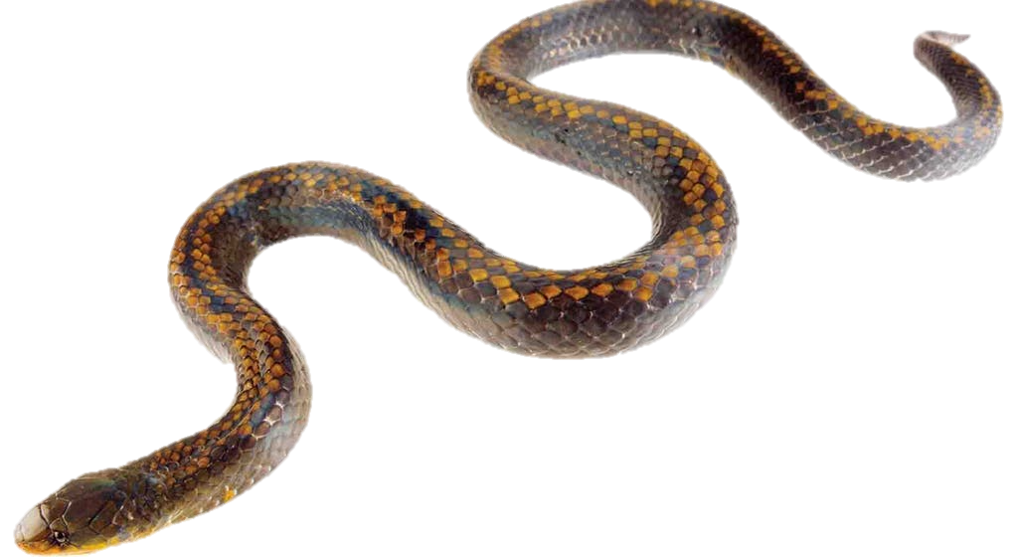
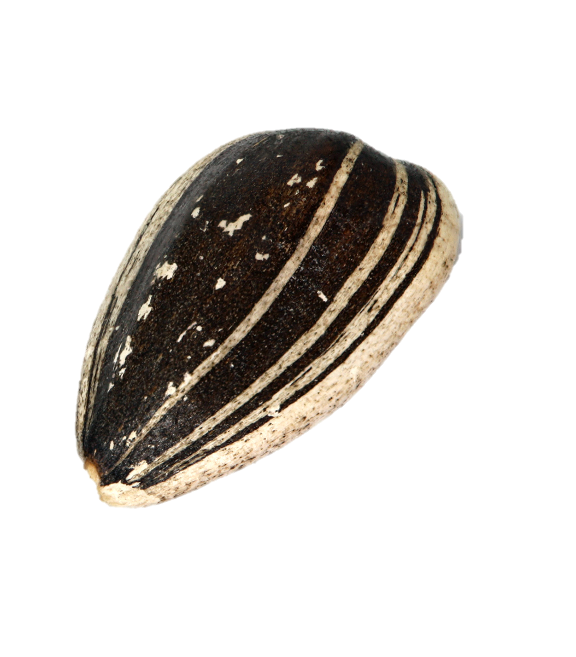
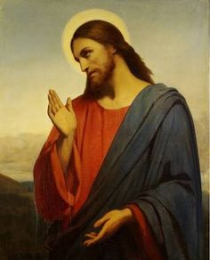
Genesis 1-3

Slide 10
How To Read a Book
Green Eggs and Ham
The Story of the Bible
Characters: (Gen 1&2) God, Adam, Eve, Serpent
Conflict: (Gen 3) Man is sinful and will die without access to the tree of life.
Rising Action: (Gen 3:15ff) Prediction of a “seed.” Looking for that seed.
Climax: The “Seed” is crucified and resurrected? Second coming of the “Seed”? The revolt of Satan against the “seed” (Rev 20:7-10).
Resolution: (Rev 20-22) Death gets killed and man gets back to the tree of life

Slide 12
mygiveonthings.com

Slide 17
The purpose of the bible
“The Bible is a story about God and how he governs/interacts with man. It is making one major argument throughout: God is good and created humans good, but they became sinful/selfish and incurred on themselves the punishment of death, from which they cannot save themselves, but this story details God and God’s way of resolving that problem, namely, sending his son to pay the penalty of death, and give eternal life to those who have faith in him to do so.” – Stephen Curto (2 Tim 3:15; Romans 15:4)

