Slide 1
Revelation Pt 3
Heavenly Scene Ch 4-5
By Stephen Curto
For Homegroup
March 24, 2019

Slide 2
Context

Slide 3
Context

Slide 4
Our Outline
Overview/Outline of Book/"Things That are Seen" (Ch. 1)
"Things that Are" (Ch. 2-3)
After these Things: Heavenly Scene (Ch 4-5)
The Seal Judgments, 1st (((The 144,000 and The Multitude))) (6:1-8:5)
Trumpet Judgments 1-6 (Ch8-9)
2nd (((7 Thunders and Little Book; Two Witnesses))) 7th Trumpet Judgment (10:1-11:14)
3rd (((Israel’s Flight; Two Beasts; 6 scenes of hope))) (Ch. 12-14)
Bowl Judgments; 4th (((Babylon’s Fall))) (15:1-19:5)
Marriage Supper; 2nd Coming, Millennial Kingdom (Ch 19-20)
Millennial Kingdom (2nd pass) Eternal State (Ch. 21-22)

Slide 5
Heavenly Scene (Ch 4-5)
The Image
The Pieces
The Interpretation

Slide 6
Heavenly Scene (Ch 4-5)
The Image
“The first voice I heard…” (4:1)(cf. 1:11)
A throne with “one sitting” on it (4:2) (cf. Daniel 7:9-14)
Appearance “like jasper and sardius” (cf. Ex 28:20)
24 elders on thrones surround the throne (4:4)
wearing white and crowns (4:4)
Cast the crowns when falling down to worship (4:10)
Hold harp and golden bowls of incense (prayers of the saints) (5:8)
Holding a scroll with 7 seals in his right hand (5:1)
7 Lamps surrounding throne (4:5)
Which are the seven Spirits of God (4:5) (cf. Isaiah 11:1-3)

Slide 7
Heavenly Scene (Ch 4-5)
The Image
4 “living creatures” (cf Ezekiel 1{esp1:10}; 10)
“in the middle of the throne and around” (4:6)
“full of eyes in front and back” (4:6)
(1) Lion, (2) Calf, (3) Face of a man (4) Eagle
6 wings each (4:8) (cf. Is 6 Seraphim)
Always saying “Holy, Holy, Holy is the Lord God almighty who was, and who is, and who is to come.” (4:8)
Saying “Amen” when the lamb takes the scroll (5:14)

Slide 8
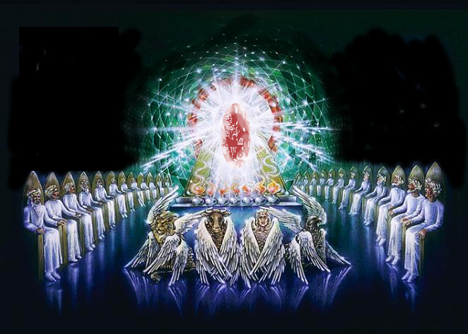

Slide 9
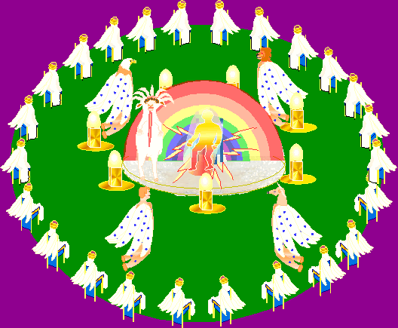

Slide 11
Heavenly Scene (Ch 4-5)
The Image
The Lamb (5:6)
Among the throne, creatures, and elders (5:6)
“Standing as if slain” (5:6)
7 horns and 7 eyes (5:6)
Which are the seven spirits of God, sent out (5:6)
Worthy to take the scroll and break the seals (5:5, 7, 9)
The lamb takes the throne and “a myriad of myriads and thousands of thousands” of angels appear worshipping the lamb (5:11-13) (cf. Dan 7:10)

Slide 12
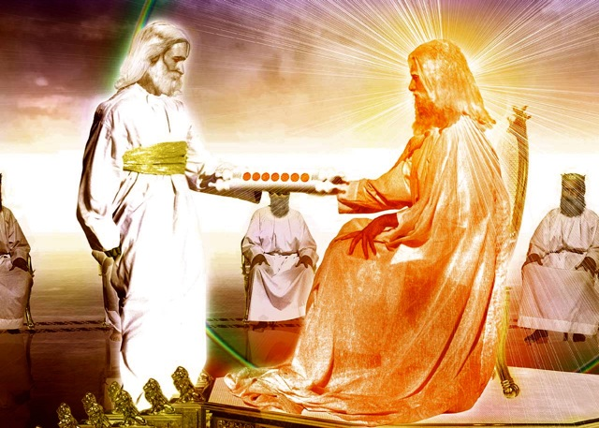
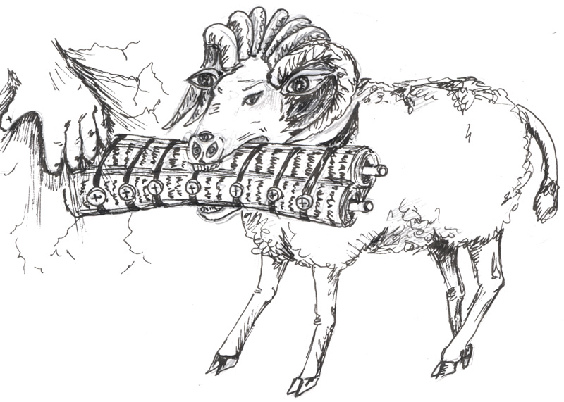

Slide 13
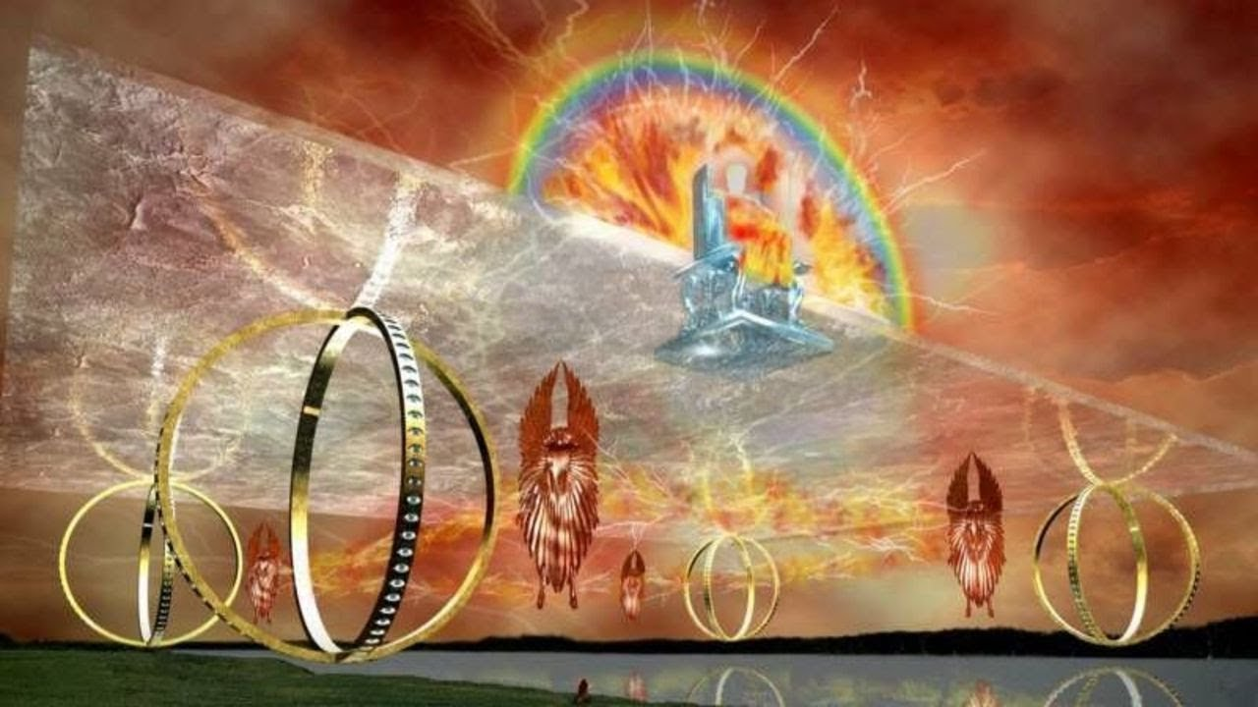
Heavenly Scene (Ch 4-5)
The Pieces
The throne and 4 living creatures
Ezekiel 1: the guardian angels of the presence of God
Eyes: sight all around i.e. they see everything
6 wings: Allusion to Isaiah 6. These are angels
Why those 4 animals? Fiercest (lion) strongest (ox/calf) highest (eagle) most glorious (man) creatures God has made. These represent his superlatives

Slide 14
Heavenly Scene (Ch 4-5)
The Pieces
24 Elders
Representatives of the church?
Clothed in white (cf. 3:4-5, 18)
Hold the “prayers of the saints”
Representatives of Israel?
The 24 officers of the priesthood (1 Chron 24:1-19)
Representative of angels?
They are in heaven surrounding God.

Slide 15
Heavenly Scene (Ch 4-5)
The Pieces
The Lamb
Jesus (John 1:29)
Lion of the tribe of Judah (Gen 49:9)
Root of David (22:16; Jer 23:5; 33:15; Isa 11:1-10; Rom 15:12)
Horns and Eyes = Authority/Rule and Sight. The 7 horns and 7 eyes are the seven spirits sent into the earth. i.e. God’s rule and authority and oversight is sent out into the earth through this lamb.

Slide 16
Heavenly Scene (Ch 4-5)
The Pieces
The scroll
The pronouncement of judgment on the earth (to be further explained in Ch 6-7)

Slide 17
Heavenly Scene (Ch 4-5)
The interpretation
The triune God is present and receiving worship as he begins the end.
For what reasons does God receive worship in these chapters? (cf. 4:8, 11; 5:9-10, 12, 13)

