Slide 1
Revelation
Introduction
By Stephen Curto
For Homegroup
March 3, 2019

Slide 2
Context

Slide 3
Context

Slide 4
Background Information
Title: The Revelation of Jesus Christ
Author: John (the son of Zebedee, brother of James)
Written From: John’s Exile on Patmos (1:9)
Date: 65 AD ? (early date) ; 90 AD (late date)
Purpose: To comfort the oppressed Churches of Asia Minor by reminding them of God’s future conquest, punishment of evil, and resurrection of the righteous.
Message: God Wins.

Slide 5
Outline (1:19)
Things You Have Seen (ch 1)
Things that Are (ch 2-3)
Things Which Will Take Place After These Things (ch 4-22)
Heavenly Scene (ch 4-5)
Tribulation (ch 6-19)
Events Following Tribulation (ch 20-22)

Slide 6
“Lunch Breaks” “Vision-ceptions” “Parenthetical Insertions”
144,ooo Jews; Multitude (ch 7)
7 Thunders & Little Book; 2 Witnesses (10:1-11:14)
Israel’s Flight; 2 Beasts; 6 Scenes of Hope (ch 12-14)
Babylon’s Fall (17:1-19:6)

Slide 7
Our Outline
Overview/Outline of Book/"Things That are Seen" (Ch. 1)
"Things that Are" (Ch. 2-3)
After these Things: Heavenly Scene (Ch 4-5)
The Seal Judgments, 1st (((The 144,000 and The Multitude))) (6:1-8:5)
Trumpet Judgments 1-6 (Ch8-9)
2nd (((7 Thunders and Little Book; Two Witnesses))) 7th Trumpet Judgment (10:1-11:14)
3rd (((Israel’s Flight; Two Beasts; 6 scenes of hope))) (Ch. 12-14)
Bowl Judgments; 4th (((Babylon’s Fall))) (15:1-19:5)
Marriage Supper; 2nd Coming, Millennial Kingdom (Ch 19-20)
Millennial Kingdom (2nd pass) Eternal State (Ch. 21-22)

Slide 8
Things You Have Seen (Ch 1)
“The revelation of Jesus Christ” (v1)
“… to show his slaves the things which must soon take place” (v1)
“And he sent and gave signs by his angel to his slave John, who testified… all that he saw” (v1-2)
“Blessed is he who reads and those who hear the words of the prophecy, and guards the things which are written in it” (v3)
“…for the time is near.” (v4)

Slide 9
Things You Have Seen (Ch 1)
John’s introduction (v4-8)
“to the seven churches who are in Asia” (v4)
”Grace to you, and peace from…”
From whom is the grace and peace? (cf. v4-5)
What does John pray for Jesus? (v5-6)
”Behold he is coming with the clouds” (v7)
Cf. Dan 7:13; Mark 14:62
“Every eye will see him… all the earth will mourn over him” (v7)
Cf. Zech 12:9-11

Slide 10
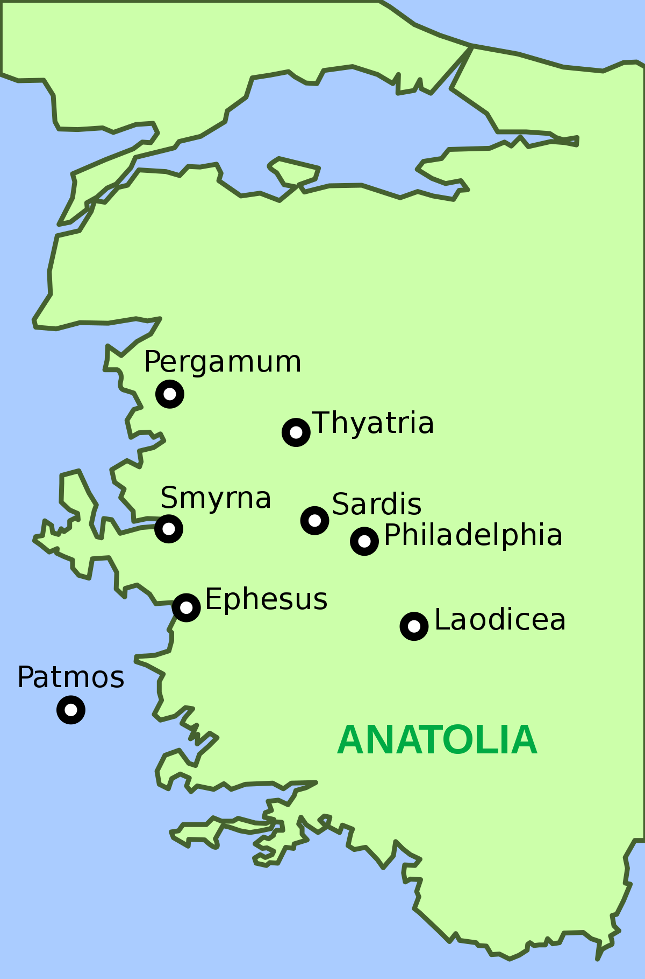
Things You Have Seen (Ch 1)
John’s Vision of Jesus (v9-20)
“I, John…was on the Island of Patmos, because of the … testimony of Jesus… In the spirit on the lord’s day, and I heard a loud voice.” (9-10)
Why was John on the Island of Patmos?
“Write in a book what you see, and send it to the seven churches…” (v11)

Slide 11
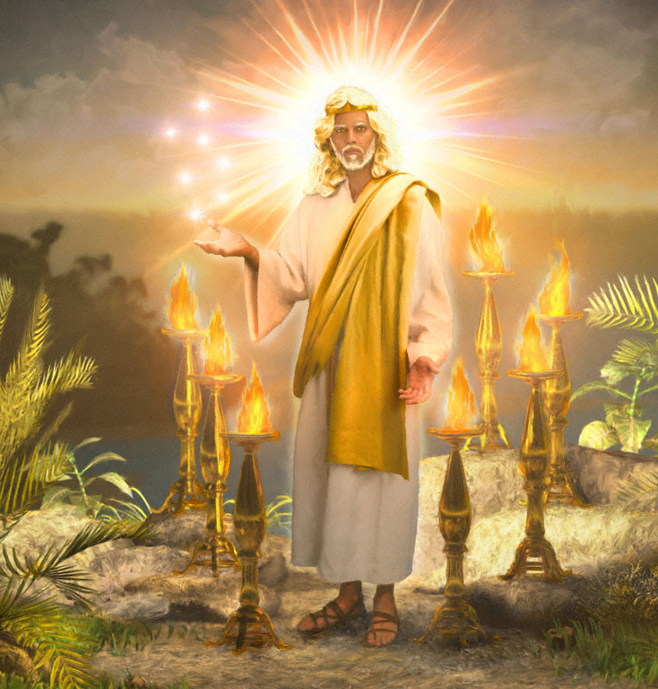
Things You Have Seen (Ch 1)
John’s Vision of Jesus (v9-20)
“And I turned, and I saw…” (v12)
7 lampstands
“one like the son of man” in their midst
He was holding 7 stars in his right hand
Description of Jesus:
Robe to his feet with a golden sash/belt
White hair
Flaming eyes
Feet of red-hot bronze
Loud voice
Sharp sword from mouth
Face like the sun shines

Slide 12
Things You Have Seen (Ch 1)
John’s Vision of Jesus (v9-20)
“do not be afraid, I am the first and the last, and the living One, I was dead, and see, I am alive forevermore.” (v17-18)
Outline of book (v19)
“The mystery of the seven stars which you saw in my right hand, and the seven golden lampstands” (v2)
Stars = angels of the seven churches
lampstands = seven churches

Slide 13
Interpreting Symbolic Visions
Does the text explain the literal referent directly after giving the symbol? (e.g. 4:5b “before the throne were burning seven torches of fire, which are the seven Spirits of God.”)
Does the text use an obvious simile? (e.g. 4:7 “the first living creature like a lion,”)
Does the text give a plain description in the midst of a list of symbolic descriptions? (e.g. 4:7 “the first living creature like a lion, the second living creature like an ox, the third living creature with the face of a man, the fourth living creature like an eagle in flight.”)

Slide 14
Interpreting Symbolic Visions
Does the text use a symbol common to scripture or specific language from a prophetic text? (e.g. 5:5 “root of David”, 5:6 “a lamb, standing as though it had been slain”, the number 7, etc.)
Does the text give a “wacky” description to an already defined referent? (e.g. 4:8 the four creatures are described as “full of eyes” and then Jesus, whom we know to be a man and already described metaphorically as a lamb, is described with 7 horns and 7 eyes in 5:6)
Does the text use key words like “spiritually” or “a sign appeared”? (11:8, 12:1)
If the answer is yes to any of these questions, then carefully interpret a symbolic meaning. If not, stick to literal interpretations.

Slide 15
Major Interpretive Methods
Preterism: The events in the book have already occurred
Historicism: The events in the book describe the unfolding of Church history
Idealism: The events in the book have no literal referent, but represent the spiritual war going on in heaven or in the hearts of believers
Futurism: The events in the book are still future and will be fulfilled literally

