Slide 1
Revelation Pt 2
“Things that Are” Ch 2-3
By Stephen Curto
For Homegroup
March 10, 2019

Slide 2
Context

Slide 3
Context

Slide 4
Our Outline
Overview/Outline of Book/"Things That are Seen" (Ch. 1)
"Things that Are" (Ch. 2-3)
After these Things: Heavenly Scene (Ch 4-5)
The Seal Judgments, 1st (((The 144,000 and The Multitude))) (6:1-8:5)
Trumpet Judgments 1-6 (Ch8-9)
2nd (((7 Thunders and Little Book; Two Witnesses))) 7th Trumpet Judgment (10:1-11:14)
3rd (((Israel’s Flight; Two Beasts; 6 scenes of hope))) (Ch. 12-14)
Bowl Judgments; 4th (((Babylon’s Fall))) (15:1-19:5)
Marriage Supper; 2nd Coming, Millennial Kingdom (Ch 19-20)
Millennial Kingdom (2nd pass) Eternal State (Ch. 21-22)

Slide 5
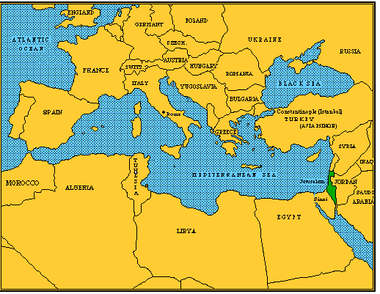
“Things that Are” Summary
Messages to each of the seven churches
Messages come from Christ
Seven messages share common pattern

Slide 6
Pattern for Each Letter:
Destination
Description of Christ (usually from Rev 1)
Commendation
Rebuke
Exhortation to change
Consequence
Exhortation to listen
Promise to overcomers from Rev 21–22

Slide 7
Church | Christ | Praise | Rebuke | Change | Promise
Ephesus (2:1-7) | Holds, walks among churches | Deeds, discern, toil, endurance | Left 1st love | Recall, repent, repeat | Tree of life
Smyrna (2:8-11) | 1st/last, dead/alive | Poverty, trib., persecut. | None | No fear of persec, faithful | 2nd death, crown of life
Pergamum (2:12-17) | Sword | Kept the faith | Balaam, Nicolaitan | Attack from sword | Stone, manna, Name
Thyatira (2:18-29) | Eyes, feet | Deeds more than at 1st | Jezebel | Hold fast | Authority, morning star
Sardis (3:1-6) | Seven spirits | Some unsoiled | Dead | Wake up | Clothed, confessed, book of life
Philadelphia (3:7-13) | David’s key | Endured, little power | None | Hold fast | Pillar, Names, kept from Trib.
Laodicea (3:14-22) | Amen, Faithful, true, creator | None | Lukewarm self-sufficient | Open door to Christ | Christ’s throne

Slide 8
Background on Cities
Ephesus – “Permitted” Known for its temple to Artemis, Church: had Timothy as pastor, founded by Paul on 2nd missionary journey, had 5 NT books addressed to them.
Smyrna – “myrrh” Center for trade and commerce and arts. Not much is known about the church or the city.
Pergamum – “Height or Elevation” A major city known for the temple of Serapis and the invention and manufacture of parchment.

Slide 9
Background on Cities
Thyatira – “Odor or Affliction” A colony of Macedonian Greeks. Made their living by the trade of arts and by dyeing things purple, the color of royalty
Sardis – “Red Ones” The capital of Lydia. Once a luxurious city, now an obscure village with extensive ruins.

Slide 10
Background on Cities
Philadelphia – “Brotherly Love” Under roman rule, founded by King Attalus II. A small town at the base of a mountain. Little is known about Philadelphia way of life.
Laodicea – “Justice of the People” (previously named Diospolis-“City of God”) destroyed by an earthquake in the 60’s. Close to Colossae and mentioned multiple times in Colossians. The worst of the churches after being rebuilt after the earthquake.

Slide 11
To Ephesus (2:1-7)
“…you have left your first love.” (v4)
What was their “first love”?
“You hate the deeds of the Nicolaitans, which I also hate.” (v6)
Who are the Nicolaitans and what are their deeds?
Nicolas (Acts 6:5)Irenaeus “Against Heresies” i.26
Antinomians (see comparison to Balaam 2:14-15)
“…I will grant to eat the tree of life which is in the paradise of God.”(v7)

Slide 12
To Smyrna (2:8-11)
“and the blasphemy of those who claim to be Jews and aren’t, but are a synagogue of Satan.” (v9)
Who are those claiming to be Jews but aren’t?
What is a “synagogue of Satan” (cf. Gen 3:15 & Rev 12:9)
“The devil is about to cast some of you into prison… and you will have tribulation for ten days.” (v10)
What does this mean?
“will not be hurt by the second death.” (v11)
What is the “second death”? (cf. Rev 21:8)

Slide 13
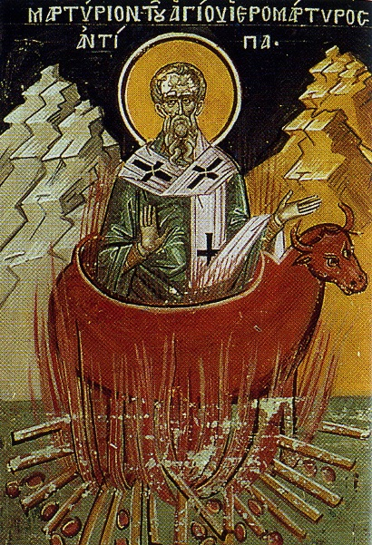
To Pergamum (2:12-17)
“where satan’s throne is” (v13)
Possibly a reference to the temple of Serapis
“Even in the days of Antipas… who was killed among you, where Satan dwells” (v13)
Antipas: early church martyr
Church tradition says he was burned in a bull-shaped altar at the temple of Serapis

Slide 14
To Pergamum (2:12-17)
“some who hold the teaching of Balaam” (v14)
What is the teaching of Balaam? (cf. Num 22-24; Rev 2:14)
“I will give him from the hidden manna and a white stone (vote), and a new name written on the stone which no one knows but he who receives it.” (v17)
A voting stone is given to the judge to determine guilt.
What is Jesus saying he will do for the overcomer here?

Slide 15
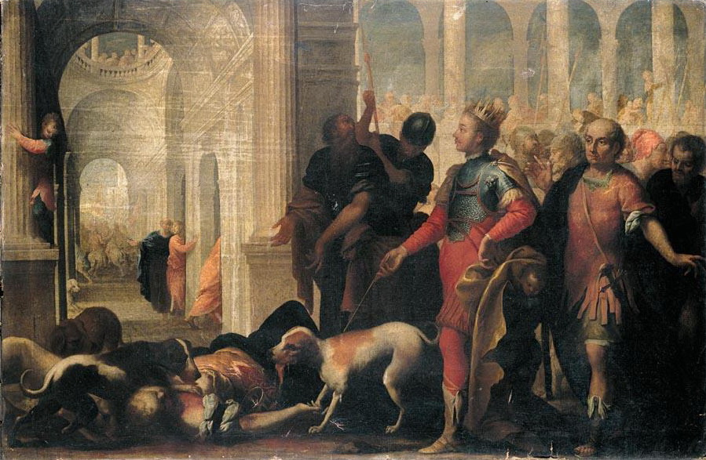
To Thyatira (2:18-29)
“You tolerate the woman Jezebel” (v20)
Who is Jezebel? (cf. 1 Kings 16, 1 Kings 18 – 2 Kings 9)
What is the Jezebel of Thyatira doing? (cf. v20)
“I will give authority over the nations” (v26, cf. 20:4)
“I will give him the morning star” (v28)(cf. 1 John 3:2; Rev 22:16)

Slide 16
To Sardis (3:1-6)
“I know your works, that you have a name that says ‘living’ but you are dead.” (v1)
“Strengthen the things about to be dead.” (v2)
“I will not erase his name from the book of life” (v5)
Does this mean he does erase some names from the book of life?

Slide 17
To Philadelphia (3:7-13)
“because you have kept the word of my perseverance, I also will keep you from the hour of testing…” (v10)
What is the “hour of testing”?
“Hold fast what you have so that no one will take your crown” (v11)
To what crown is he referring? Literal or metaphorical? (cf. 2:10)
“I will write on him…” (v12)
What will he write and why?

Slide 18
To Laodicea (3:14-22)
“I wish that you were cold or hot.” (v16)
“You say ‘I am rich and wealthy and need nothing.’”(v17)
“Behold I stand at the door and knock; if anyone hears my voice and opens the door, I will come in to him and will dine with him and he with me.” (v20)
What is meant by this instruction?
“…to sit down with me on my throne as I also sat down with my Father.” (v21)

Slide 19
Historico Prophetic View?
Church | Scripture | Era | Years AD
Ephesus | 2:1-7 | Apostolic | 33–64
Smyrna | 2:8-11 | Persecuted | 64–313
Pergamum | 2:12-17 | Church/state union | 313–606
Thyatira | 2:18-29 | Middle Ages | 606–1520
Sardis | 3:1-6 | Reformation | 1520–1750
Philadelphia | 3:7-13 | Missionary | 1750–1900
Laodicea | 3:14-22 | Modern | 1900–present

