Slide 1
Revelation Pt 4
Seal Judgments and Lunch Break #1 (Ch 6-7)
By Stephen Curto
For Homegroup
March 31, 2019

Slide 2
Our Outline
Overview/Outline of Book/"Things That are Seen" (Ch. 1)
"Things that Are" (Ch. 2-3)
After these Things: Heavenly Scene (Ch 4-5)
The Seal Judgments, 1st (((The 144,000 and The Multitude))) (6:1-8:5)
Trumpet Judgments 1-6 (Ch8-9)
2nd (((7 Thunders and Little Book; Two Witnesses))) 7th Trumpet Judgment (10:1-11:14)
3rd (((Israel’s Flight; Two Beasts; 6 scenes of hope))) (Ch. 12-14)
Bowl Judgments; 4th (((Babylon’s Fall))) (15:1-19:5)
Marriage Supper; 2nd Coming, Millennial Kingdom (Ch 19-20)
Millennial Kingdom (2nd pass) Eternal State (Ch. 21-22)

Slide 3
Context

Slide 4
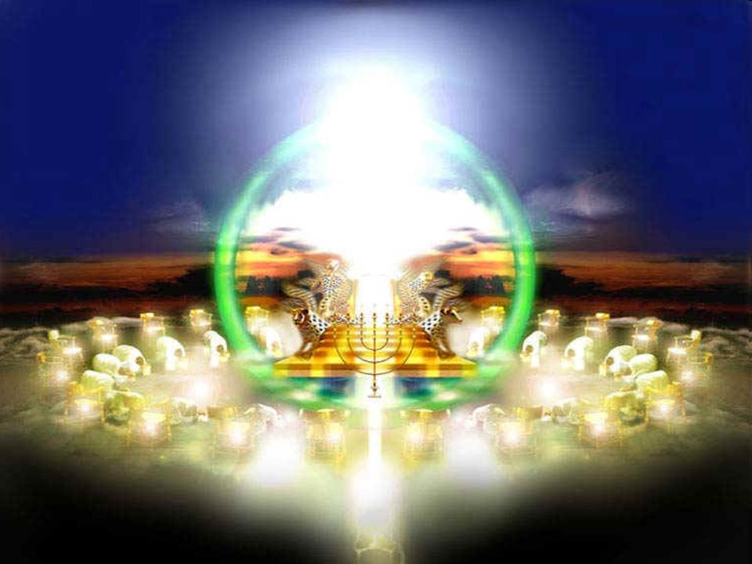
Context

Slide 5
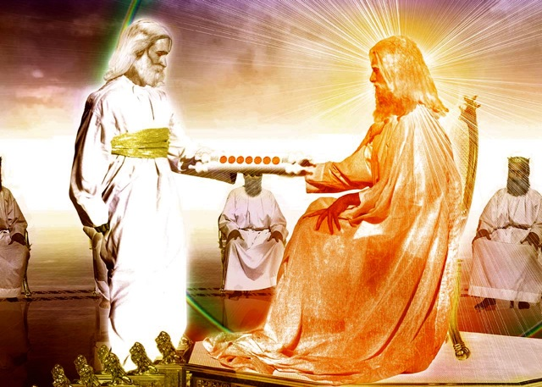

Slide 6
Outline
Structure of the Judgments: 3 Options?
First 6 Seal Judgments (Ch 6)
1st Lunch Break (((The 144,000 and The Multitude))) (Ch 7)
7th Seal Judgment (8:1-5)

Slide 7
Structure of the Judgments: 3 Options?
Backbone structure of Revelation 6-17
7 Seal Judgments, 7 Trumpet Judgments, 7 Bowl Judgments
All 3 sets have a Lunch Break between 6 and 7
1 2 3 4 5 6 (Lunch Break) 7
In what order do these 3 sets actually unfold in real time, on earth?

Slide 8
Structure of the Judgments: 3 Options?
Option 1: Telescoping
Option 2: Successive (Chronological)
Option 3: Concurrent (Recapitulation)

Slide 9
Structure of the Judgments: 3 Options?
Option 1: Telescoping
1 2 3 4 5 6 7
1 2 3 4 5 6 7
1234567

Slide 10
Structure of the Judgments: 3 Options?
Option 1: Telescoping

Slide 11
Structure of the Judgments: 3 Options?
Option 2: Successive (Chronological)
Seals Trumpets Bowls
1 2 3 4 5 6 7 1 2 3 4 5 6 7 1 2 3 4 5 6 7

Slide 12
Structure of the Judgments: 3 Options?
Option 3: Concurrent (Recapitulation)
Seals: 1 2 3 4 5 6 7
Trumpets: 1 2 3 4 5 6 7
Bowls: 1 2 3 4 5 6 7

Slide 13
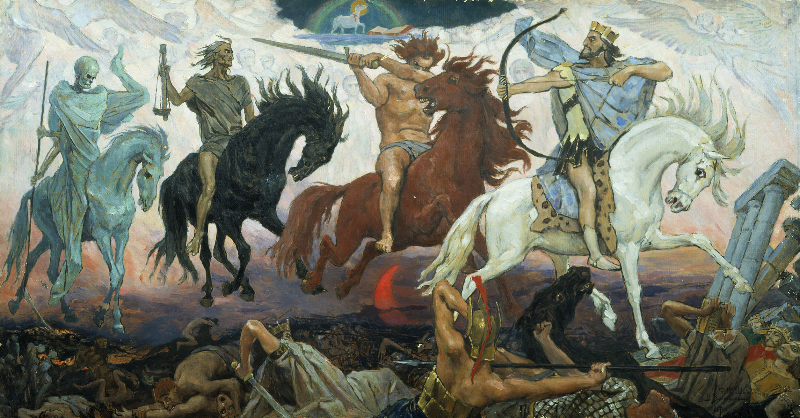
First 6 Seal Judgments (6:1-17)
“Come”

Slide 14
First 6 Seal Judgments (6:1-17)

Slide 15
First 6 Seal Judgments (6:1-17) – Seal #1

Slide 16
First 6 Seal Judgments (6:1-17) – Seal #1
“Come”
White horse
Bow
Crown
“Went out conquering and to conquer…”

Slide 17
First 6 Seal Judgments (6:1-17) – Seal #1

Slide 18
First 6 Seal Judgments (6:1-17) – Seal #2

Slide 19
First 6 Seal Judgments (6:1-17) – Seal #2
“Come”
Red horse
Sword
“to take peace from the earth that men would slay one another…”
I.e. WAR

Slide 20
First 6 Seal Judgments (6:1-17) – Seal #2

Slide 21
First 6 Seal Judgments (6:1-17) – Seal #3

Slide 22
First 6 Seal Judgments (6:1-17) – Seal #3
“Come”
Black horse
Scales
“A quart of wheat for a denarius, 3 quarts of barley for a denarius, and do not damage the oil and the wine!”

Slide 23
First 6 Seal Judgments (6:1-17) – Seal #3

Slide 24
First 6 Seal Judgments (6:1-17) – Seal #4

Slide 25
First 6 Seal Judgments (6:1-17) – Seal #4
“Come”
Green horse
(sickly/pale)
Rider named Death
Hades with him
Authority to kill ¼ of the earth with sword/famine/pests/beasts

Slide 26
First 6 Seal Judgments (6:1-17) – Seal #4

Slide 27
First 6 Seal Judgments (6:1-17) – Seal #5

Slide 28
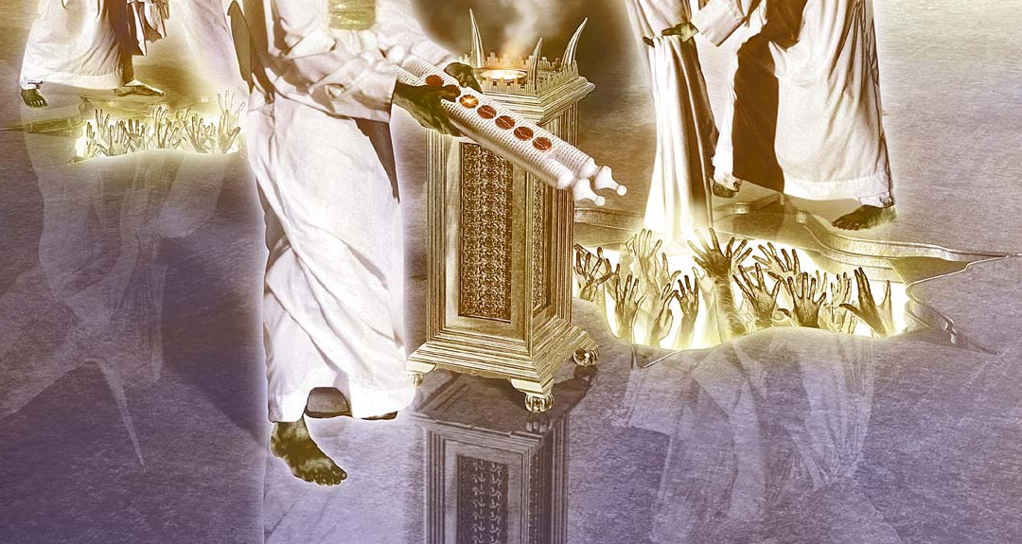
First 6 Seal Judgments (6:1-17) – Seal #5
Souls of martyrs crying “How long, holy and true ruler, will you not judge and avenge our blood because of those who dwell on the earth?”
Given white robes and told to “cease” a little while longer until the number of their fellow martyrs was completed

Slide 29
First 6 Seal Judgments (6:1-17) – Seal #5

Slide 30
First 6 Seal Judgments (6:1-17) – Seal #6

Slide 31
First 6 Seal Judgments (6:1-17) – Seal #6

Slide 32
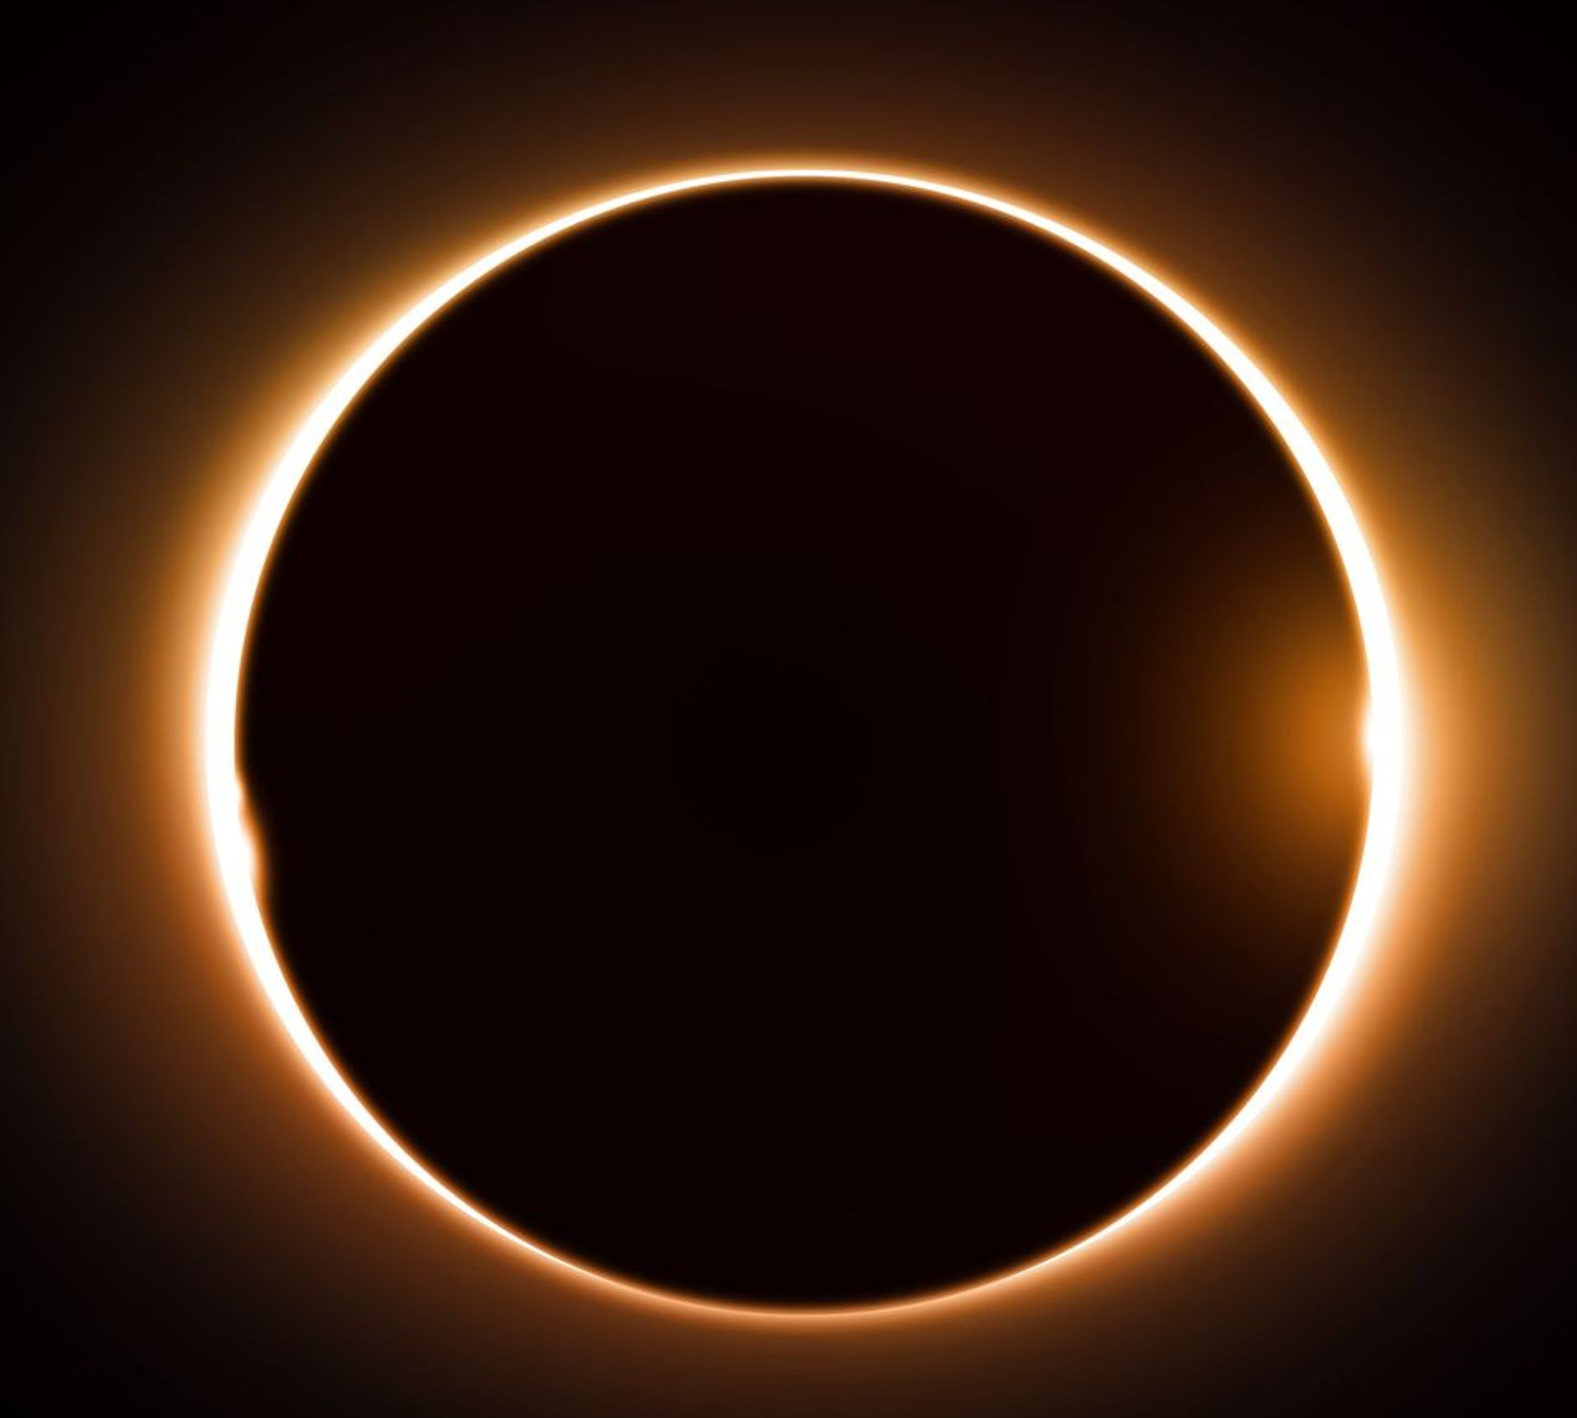
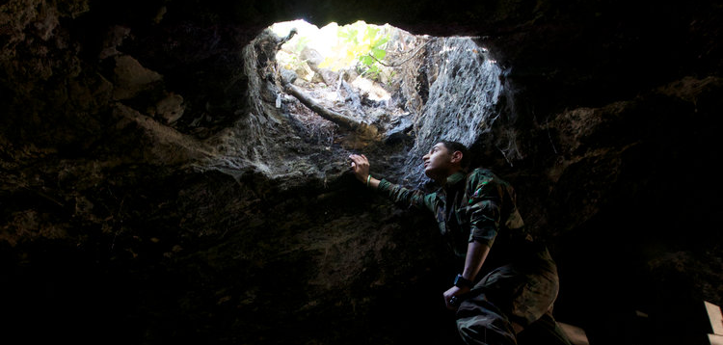
First 6 Seal Judgments (6:1-17) – Seal #6
Earthquake, black sun, red moon, stars fall, sky split
All men hide in the caves saying to the rocks “Fall on us and hide us from the presence of Him who sits on the throne, and from the wrath of the Lamb, for the great day of their wrath has come, and who is able to stand?”

Slide 33
1st Lunch Break (Ch 7)
4 Angels
“Holding back the four winds of the earth” (7:1) – i.e. preventing destruction
About to unleash the winds, thus bringing destruction
Stopped by a fifth angel who “has the seal of the living God” (7:2)
Cf. Zech 6:1-8 “The four winds of heaven”
The 144,000
The Multitude

Slide 34
1st Lunch Break (Ch 7)
4 Angels
The 144,000
Those “sealed” prior to the destruction brought by the 4 angels
12,000 from each tribe of Israel
Are there not non-Israelite “slaves of God” (7:3) on earth at the time? If not, why not? If so, why aren’t they sealed?
List of tribes: omits Dan, and Ephraim; Includes Levi, Manasseh, and Joseph (cf. Gen 48:17-22; 49:16-18)
The Multitude

Slide 35
1st Lunch Break (Ch 7)
4 Angels
The 144,000
The Multitude
From every tribe, nation, people and tongue (7:9)
Clothed in white with palm branches (7:9)
Worshipping with the angels in the throne room (7:10-11)
“The ones coming from the great tribulation…” (7:14)
i.e. the Raptured Church, destined for the new earth (cf. description in 7:15-17)

Slide 36
7th Seal (8:1-5)

Slide 37
7th Seal (8:1-5)

Slide 38
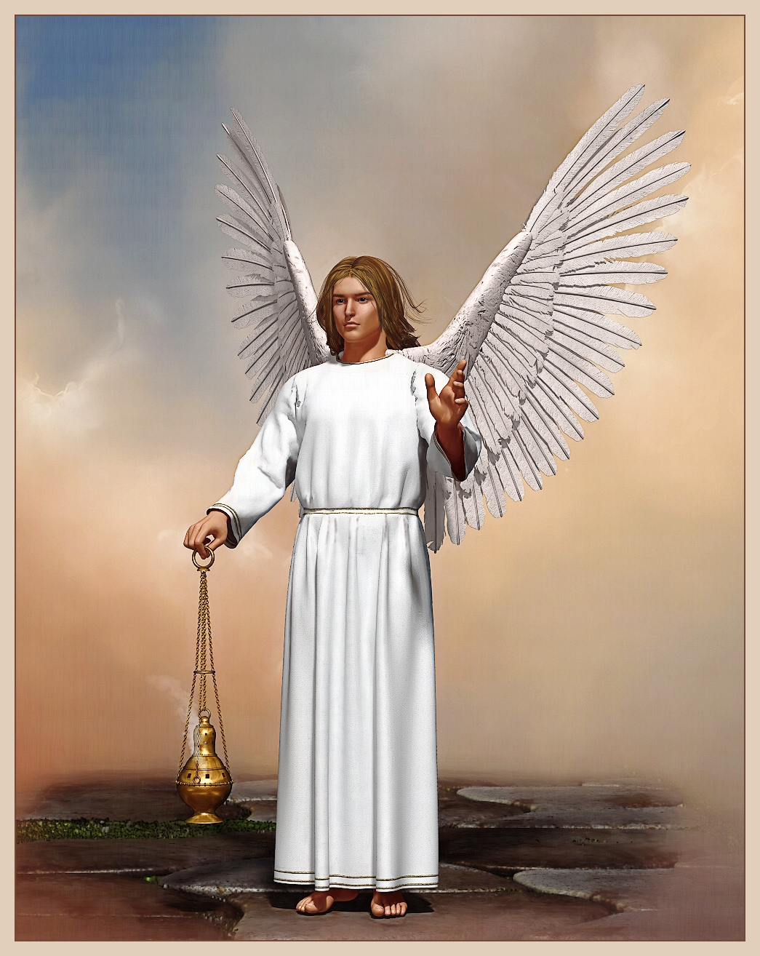
7th Seal (8:1-5)
30 min silence
7 angels with 7 trumpets
1 angel
Golden censer
Adds incense to prayers of saints
Throws fire from altar on earth

