Slide 1
Revelation Pt 6
Lunch Break #2 (Ch 10-11) & Trumpet 7
By Stephen Curto
For Homegroup
April 14, 2019

Slide 2
Our Outline
Overview/Outline of Book/"Things That are Seen" (Ch. 1)
"Things that Are" (Ch. 2-3)
After these Things: Heavenly Scene (Ch 4-5)
The Seal Judgments, 1st (((The 144,000 and The Multitude))) (6:1-8:5)
Trumpet Judgments 1-6 (Ch8-9)
2nd (((7 Thunders and Little Book; Two Witnesses))) 7th Trumpet Judgment (10:1-11:14)
3rd (((Israel’s Flight; Two Beasts; 6 scenes of hope))) (Ch. 12-14)
Bowl Judgments; 4th (((Babylon’s Fall))) (15:1-19:5)
Marriage Supper; 2nd Coming, Millennial Kingdom (Ch 19-20)
Millennial Kingdom (2nd pass) Eternal State (Ch. 21-22)

Slide 3
Context

Slide 4
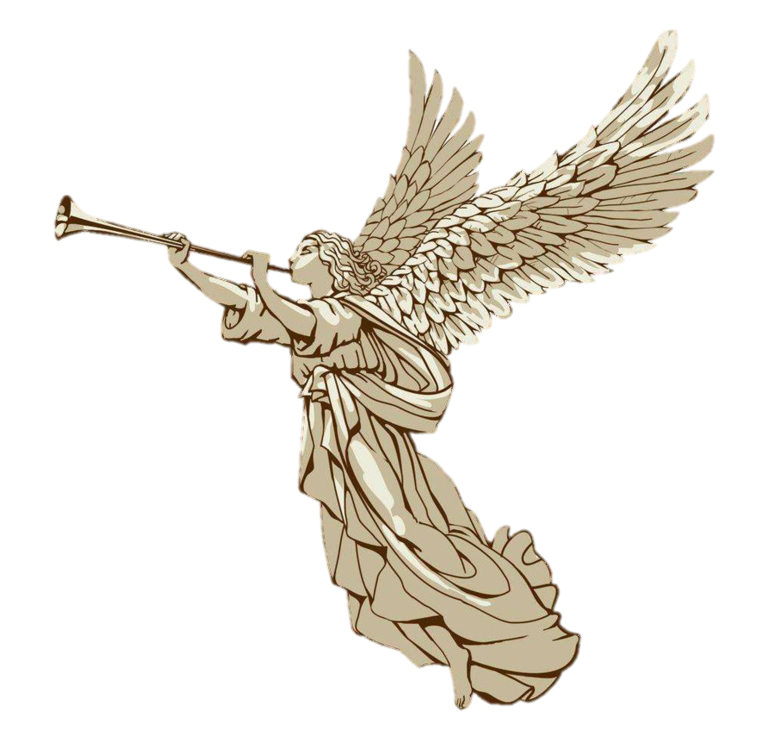
Trumpets 1-6 (Ch 8-9)
Hail and fire mixed with Blood; 1/3 earth burned up
Fire mount in sea; 1/3 sea blood and died
Burning star from heaven; 1/3 fresh water spoiled
1/3 sun moon and stars; eagle with 3 woes
Apollyon falls to earth, opens abyss/ releases demons
4 angels with 200 mil horsemen; 1/3 men die; survivors don’t repent

Slide 5
Outline
7 Thunders and Little Book
Two Witnesses
7th Trumpet

Slide 6
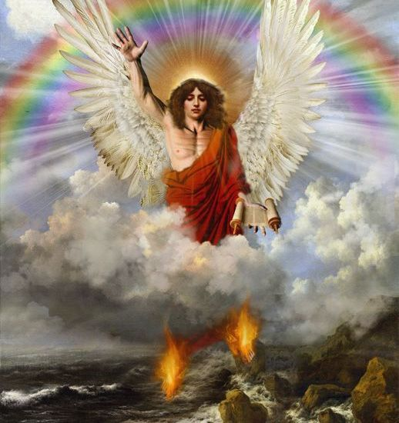
7 Thunders and Little Book
Strong angel stands on sea and land
Holds small book
Cries with loud voice
The seven thunders spoke their own voice
John instructed to seal up what the seven thunders said

Slide 7
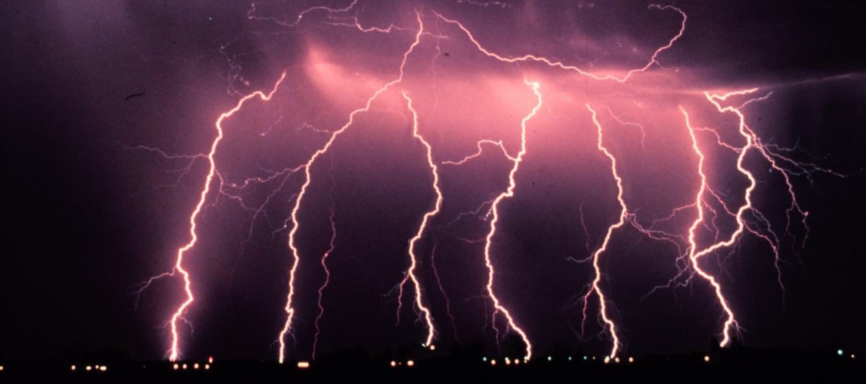
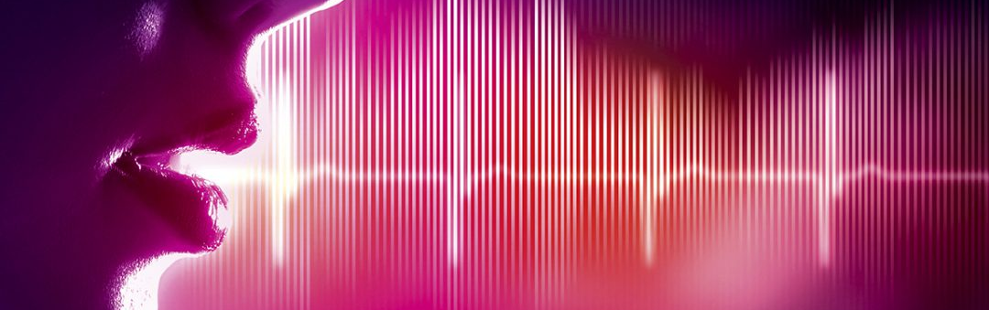
7 Thunders and Little Book
“Seal up the things the seven thunders said, and do not write them.” (10:4)
βροντή “thunder” is more literally “roars” or “crowd noises,” think of a stadium chanting something

Slide 8
7 Thunders and Little Book
Angel quotes introduction to 10 commandments (Ex 20:11)
“There will be delay no longer” (10:6)
“…in the days of the sound of the seventh angel, when he is about to sound, then the mystery of God is finished as he preached to His own servants the prophets.”
Which angel is “the seventh?”
What mystery is being referenced? (cf. Rom 11 :25-27; 1 Cor 2:7; 4:1; Eph 1:9; 3:3-9; Col 1:26-27)

Slide 9
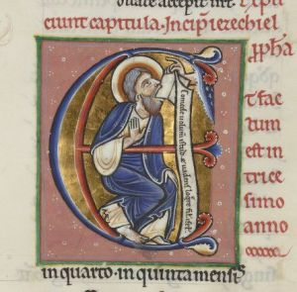
7 Thunders and Little Book
John takes the little scroll (book) from the angel
“take it and eat it”
Did he really eat a book? (cf. Ezk 3:1-3)
Sweet to the mouth, bitter to the stomach
What is the meaning here?

Slide 10
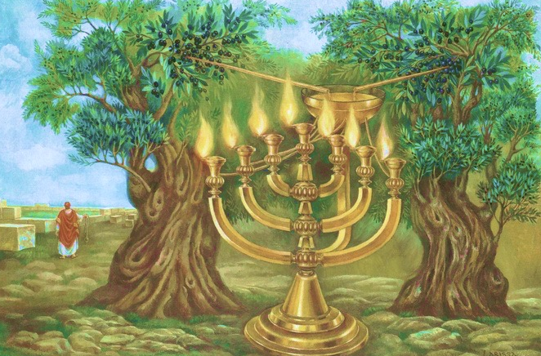
Two Witnesses
John measure the temple of God
What temple?
Leaves out the court because it has been given to the nations to trample for 42 months
Two witnesses given authority
Prophesy 1260 days
“These are the two olive trees and lampstands that stand before the Lord of the earth” (cf. Zech 4 [esp v14])

Slide 11
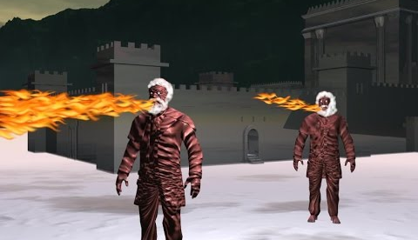
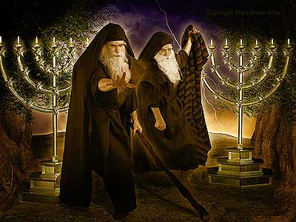
Two Witnesses
Fire flows from their mouth to devour enemies
Power to perform plagues
Beast coming from the abyss will kill them
Bodies will “lie in the streets of the great city, which is spiritually called Sodom and Egypt” (11:8)

Slide 12
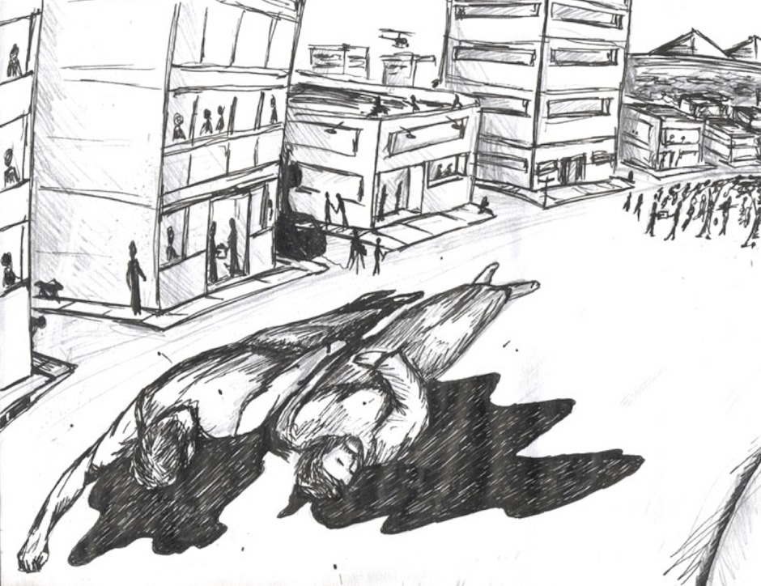
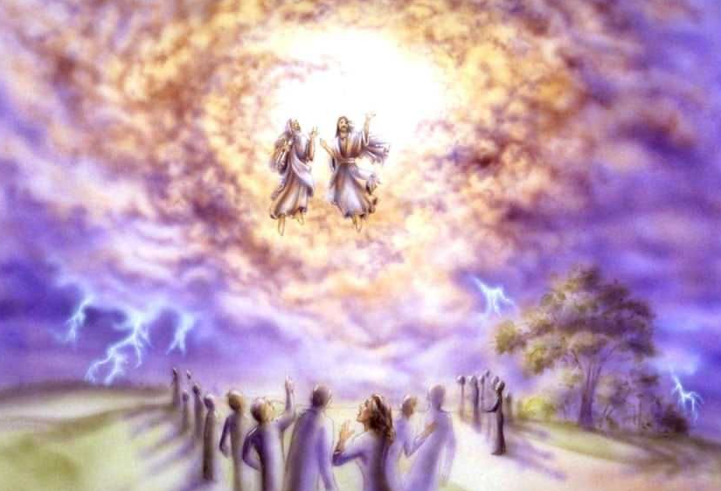
Two Witnesses
The nations will prevent their burial for 3.5 days, then resurrected causing fear among the nations who celebrated their death
Earthquake killing 7,000
“The second woe is past, behold the third woe is coming quickly…”

Slide 14
7th Trumpet
Hail and fire mixed with Blood; 1/3 earth burned up
Fire mount in sea; 1/3 sea blood and died
Burning star from heaven; 1/3 fresh water spoiled
1/3 sun moon and stars; eagle with 3 woes
Apollyon falls to earth, opens abyss/ releases demons
4 angels with 200 mil horsemen; 1/3 men die; survivors don’t repent
Kingdom transform; ark revealed, lightning/thunder/ earthquake

