Slide 1
Revelation Pt 7
Lunch Break #3 (Ch 12-14)
By Stephen Curto
For Homegroup
April 28, 2019

Slide 2
Our Outline
Overview/Outline of Book/"Things That are Seen" (Ch. 1)
"Things that Are" (Ch. 2-3)
After these Things: Heavenly Scene (Ch 4-5)
The Seal Judgments, 1st (((The 144,000 and The Multitude))) (6:1-8:5)
Trumpet Judgments 1-6 (Ch8-9)
2nd (((7 Thunders and Little Book; Two Witnesses))) 7th Trumpet Judgment (10:1-11:14)
3rd (((Israel’s Flight; Two Beasts; 5 scenes of hope))) (Ch. 12-14)
Bowl Judgments; 4th (((Babylon’s Fall))) (15:1-19:5)
Marriage Supper; 2nd Coming, Millennial Kingdom (Ch 19-20)
Millennial Kingdom (2nd pass) Eternal State (Ch. 21-22)

Slide 3
Context

Slide 4
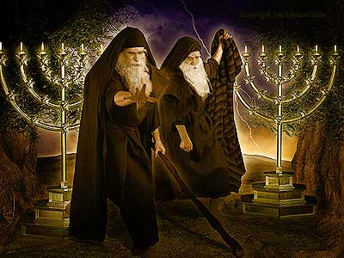
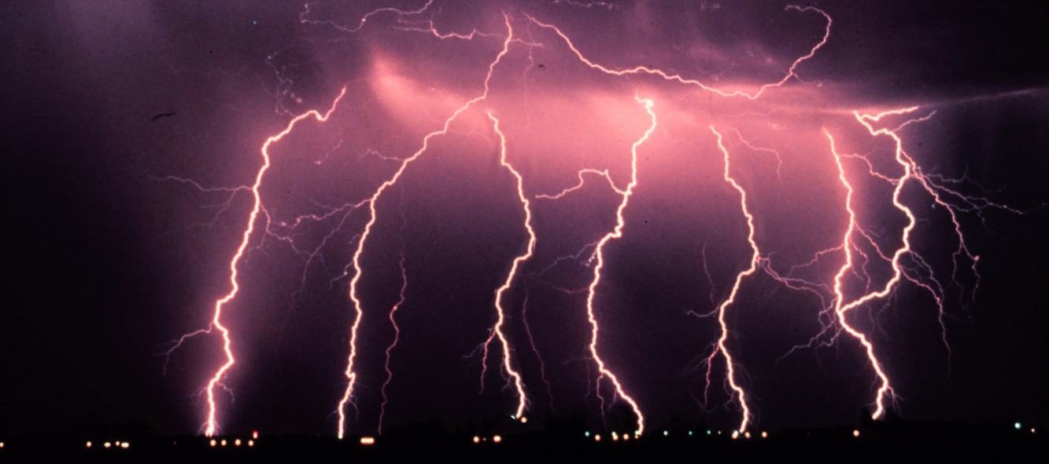
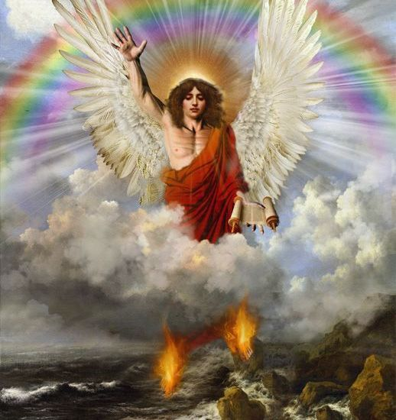
Review

Slide 5
Outline
Israel’s Flight (Ch 12)
Two Beasts (Ch 13)
5 Scenes of Hope (Ch 14)

Slide 6
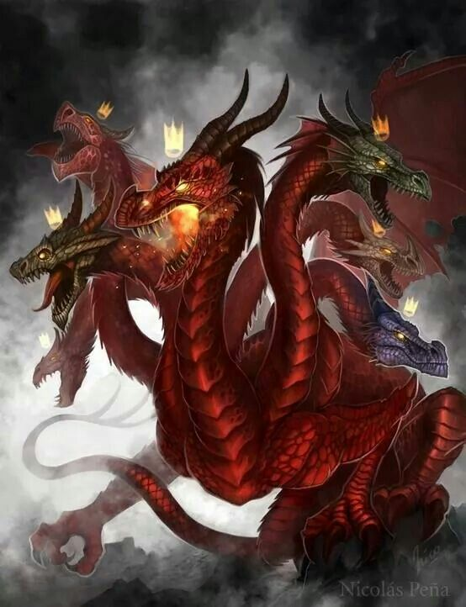
Israel’s Flight (Ch 12)
“A Great sign appeared in heaven” (v1)
A Woman (v1-2)
Clothed with sun, moon under her feet
Crown of 12 stars
Labor
A Dragon (v3-4)
7 heads with crowns and 10 horns
Tail swept 1/3 of stars
Stood before woman to devour her child at birth

Slide 7
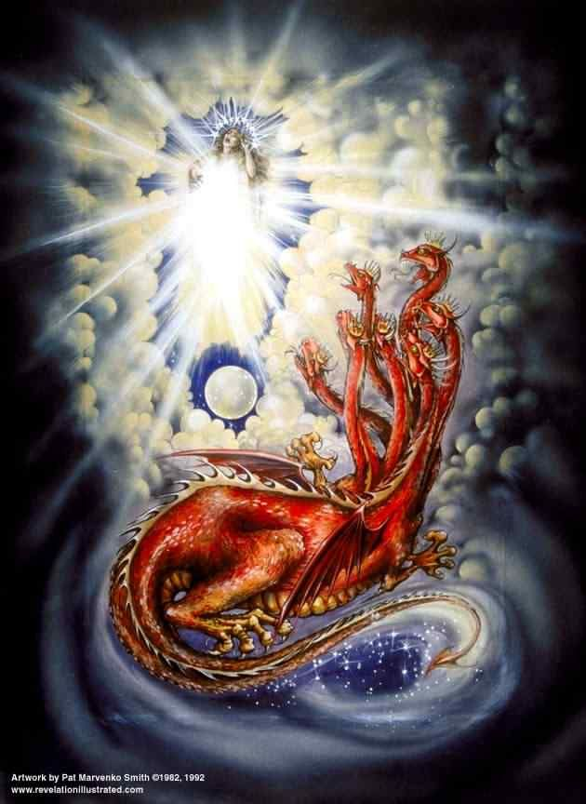
Israel’s Flight (Ch 12)
The Woman (cf. Gen 37:9ff)
Israel, Mary? Church? Mother Earth?
The Dragon = Satan (Rev 12:9)
7 heads with crowns and 10 horns (cf. Dan 7:1-8)
Tail swept 1/3 of stars = Fall of Demons? (v7-9)
Stood before woman to devour her child at birth = Attempt to prevent Messiah from work (cf. Matt 4:1-11; 16:23; etc.)

Slide 8
Israel’s Flight (Ch 12)
Woman gives birth to son
“And her child was caught up (ἁρπαζω, harpazo) to God and to His throne.” (v5)
Pre-trib Rapture?
Then the woman fled into the wilderness where she had a place prepared by God, so that there she would be nourished for 1260 days” (v6)

Slide 9
Israel’s Flight (Ch 12)
War in heaven (v7-9)
Michael (cf. Dan 10:13; 12:1-3)
“And there was no longer a place found for them in heaven” (v8)
Rejoicing in heaven (v10-12)
”salvation and power and kingdom of our God and the authority of His Christ have come…” (v10)
“they overcame him because of the blood of the Lamb and the word of their testimony, and they did not love their life even unto death.” (v11)
Who are these people?

Slide 10
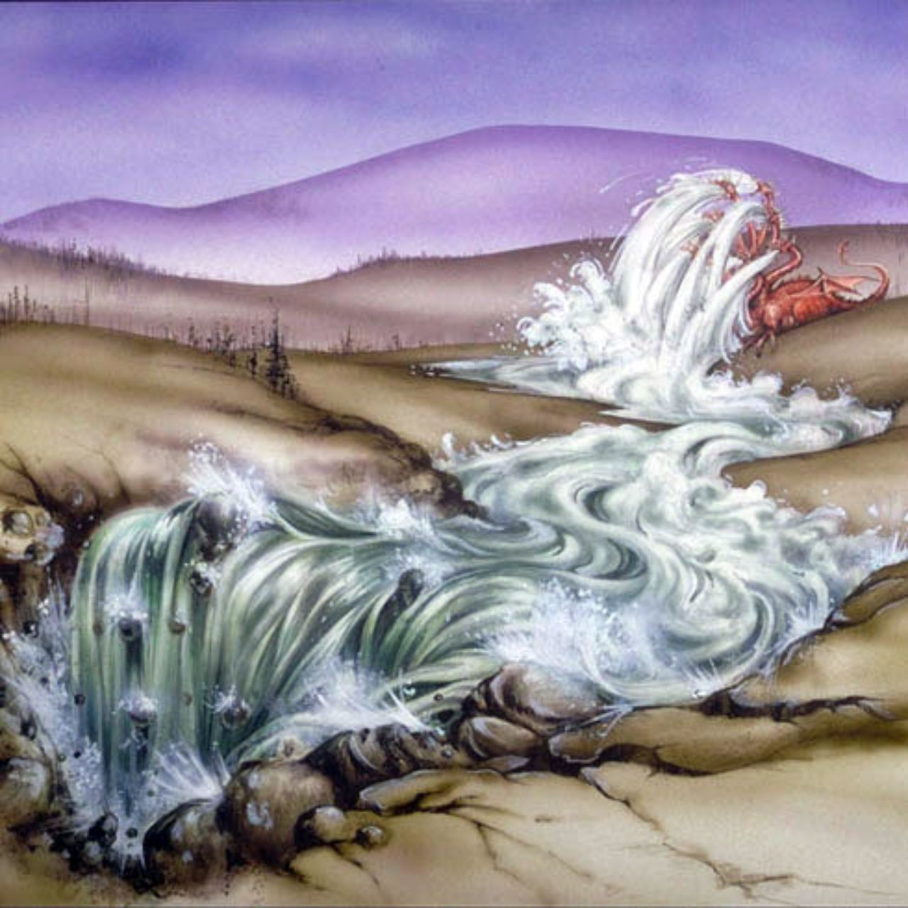
Israel’s Flight (Ch 12)
Woman in Wilderness (v13-17)
Dragon persecutes woman
Woman escapes to wilderness for ”a time, times, and half a time” (v14) (cf. Dan 7:25; 12:7)
Poured river from his mouth, but earth drank it up
“So the dragon was enraged with the woman, and went off to make war with the rest of her children, who keep the commandments of God and hold to the testimony of Jesus.” (12:7) (cf. Dan 7:25-27; 12:7)

Slide 11
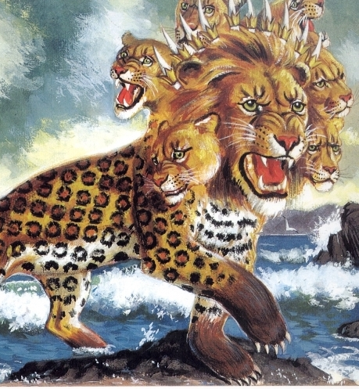
Two Beasts (Ch 13)
“The Beast” 1st Beast (v1-10)
From the sea (v1)
7 heads w/crowns and blasphemous names 10 horns (v1)
Leopard, bear, lion (v2)
One head appears slain then healed (v3)
Worshipped (v4)
Authority to act 42 months (v5-6)
Make war with the saints (v7-10)

Slide 12
Two Beasts (Ch 13)
“The Prophet” 2nd Beast (v11-18)
From the earth (land) (v11)
2 horns like the lamb spoke like the dragon (v11)
Makes the earth worship 1st beast
Performs miracles (v13)
Gets men to make image of 1st beast and gives breath to it (v14-15)
Causes shutdown of all trade without mark of 1st beast he gives (v16-17)

Slide 13
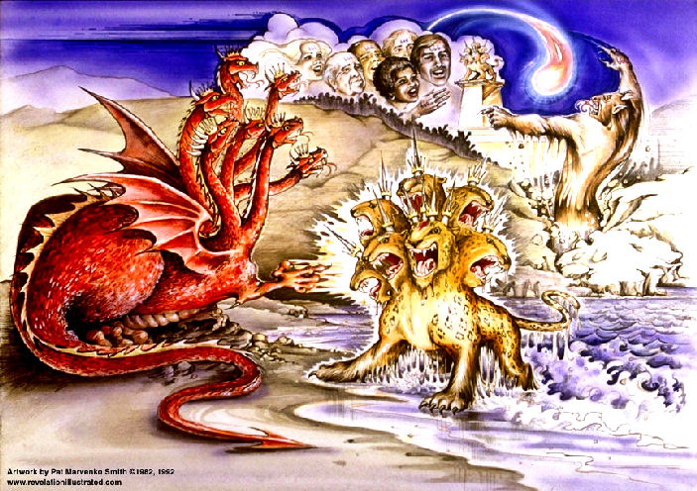
Two Beasts (Ch 13)

Slide 14
Two Beasts (Ch 13)
“The Beast” 1st Beast (v1-10)
From the sea (v1) – Gentile Nations (Dan 7; Jer 47:1-2)
7 heads w/crowns and blasphemous names; 10 horns (v1) – identification with the Dragon; specific kings?
Leopard, bear, lion (v2) - Daniel 7:1-10
One head appears slain then healed (v3) – meaning?
Worshipped (v4)
Authority to act 42 months (v5-6)
Make war with the saints (v7-10)

Slide 15
Two Beasts (Ch 13)
“The Prophet” 2nd Beast (v11-18)
From the earth (land) (v11) – Jewish?
2 horns like the lamb spoke like the dragon (v11) – Deceiving appearance, know him by his words
Makes the earth worship 1st beast
Performs miracles (v13)
Gets men to make image of 1st beast and gives breath to it (v14-15) (cf. Gen 1:27; 2:7)
Causes shutdown of all trade without mark of 1st beast he gives (v16-17)

Slide 16
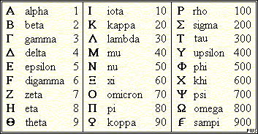
Two Beasts (Ch 13)
“Let him who has understanding calculate the number of the beast; for the number is of a man, and his number is 666.”
Some manuscripts χξς or χξϝ
https://www.youtube.com/watch?v=jNo321ZxFmY

Slide 17
5 Scenes of Hope (Ch 14)
Preservation of the 144,000 (v1-5)
Eternal Gospel (v6-7)
Fall of Babylon Predicted (v8)
Curses and Blessings (v9-13)
Heavenly Harvesters (v14-20)

Slide 18
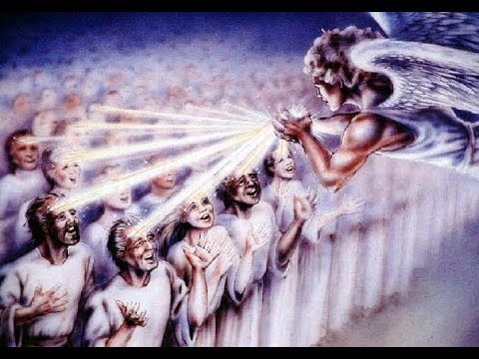
5 Scenes of Hope (Ch 14)
Preservation of the 144,000 (v1-5)
Standing on Zion, mark of the king, learn a new song, ”virgins”, purchased as first fruits to God and to the lamb, blameless
First fruits of what?
Eternal Gospel (v6-7)
Fall of Babylon Predicted (v8)
Curses and Blessings (v9-13)
Heavenly Harvesters (v14-20)

Slide 19
5 Scenes of Hope (Ch 14)
Preservation of the 144,000 (v1-5)
Eternal Gospel (v6-7)
“Fear God and give him glory, because the hour of his judgment has come; worship him who made heaven, and earth, and sea, and fresh water.”
(Cf Deut 10:12; Ecc 12:13)
Fall of Babylon Predicted (v8)
Curses and Blessings (v9-13)
Heavenly Harvesters (v14-20)

Slide 20
5 Scenes of Hope (Ch 14)
Preservation of the 144,000 (v1-5)
Eternal Gospel (v6-7)
Fall of Babylon Predicted (v8)
“Fallen is Babylon the great, she who has made all the nations drink of the wine of her immorality.”
To which Babylon is he referring?
(cf. Dan 4:30)
Curses and Blessings (v9-13)
Heavenly Harvesters (v14-20)

Slide 21
5 Scenes of Hope (Ch 14)
Preservation of the 144,000 (v1-5)
Eternal Gospel (v6-7)
Fall of Babylon Predicted (v8)
Curses and Blessings (v9-13)
Curses on Beast Worshippers (9-11)
Blessing for the Martyrs (v12-13)
Rest (v11, 13)
Cf. Deut 28
Heavenly Harvesters (v14-20)

Slide 22
5 Scenes of Hope (Ch 14)
Preservation of the 144,000 (v1-5)
Eternal Gospel (v6-7)
Fall of Babylon Predicted (v8)
Curses and Blessings (v9-13)
Heavenly Harvesters (v14-20)
Son of Man with gold crown, angel informs him ”The hour has come” (cf. Matt 24:36ff), He reaps the earth
Angel from 8:1-5 (Seal 7) reaps “the vine of the earth” and throws them in the “winepress of the wrath of God”; river of blood
Cf. Joel 3:13

