Slide 1
The Sunday Worship Service
The Why and How of the Sunday Morning Church Service
Part 1: Defining the Question and Understanding the History
By Stephen Curto
For Homegroup
Sept 15, 2019

Slide 2
Lesson Outline
Review
Corporate vs Private Worship
Prescriptions
Teaching (Preaching?)
Singing
Prayer
Confession
Giving charity
Communion
Loving/serving one another
quiet times

Slide 3
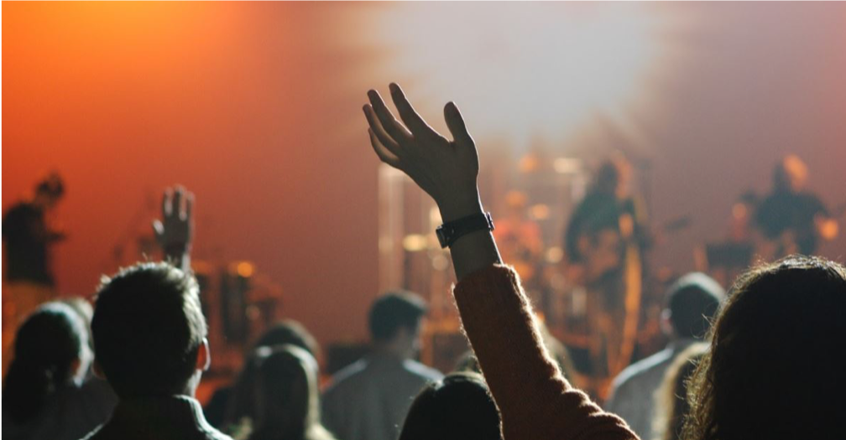
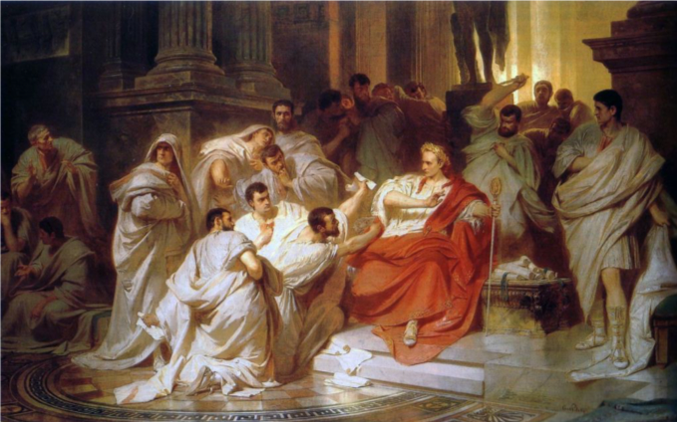
Defining the Topic
What is “worship”?
What is “church”?
What are the components of a “worship service”?

Slide 4
Defining the Topic
Brief Review
The nature of the universal church
The nature of the local church

Slide 5
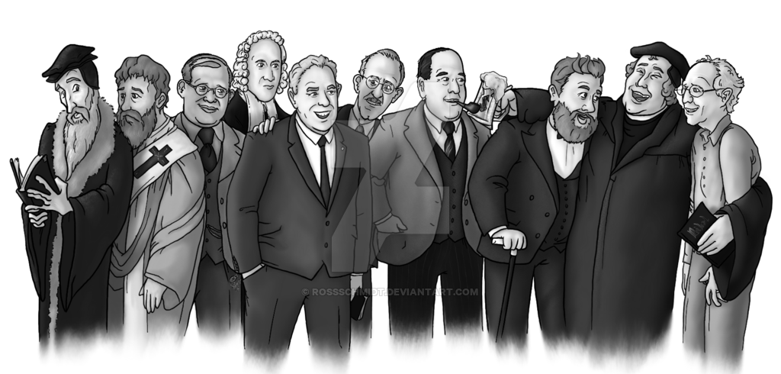
Defining the Topic
Brief Review
The nature of the universal church
Invisible membership united solely by belief in Christ; his “sheep” his “followers” his “disciples” (John 10; 20:31; Eph 2-3; 1 Pet 2)
Body of Christ (1 Cor 6; 12; 15; Ephesians; Colossians)
Consists of those who are “descendants of Abraham by faith” (Rom 9-11)
Gathers in local geographic assemblies (Heb 10:25; Every Epistle in the NT; Rev 2-3)
The nature of the local church

Slide 6
Defining the Topic
Brief Review
The nature of the universal church
The nature of the local church
A geographic gathering, ἐκκλησία, or “church” of people united and submitting to a local group of elders (1 Tim 2-3; Titus; Acts 14:23; 15; 20:17; Phil 1:1; 1 Pet 5)
Local gathering contains believers and un-believers/false converts (1 John 2:19; 1 Cor 6; Matt 7:15-23; 18:15-17; 2 Pet 2)

Slide 7
Our question to study:
What is the nature, purpose, and correct format
of the regular local gathering?

Slide 8
Biblical Definition of Worship
“Worship” προσκυνέω or σέβω
proskuneo: “to worship” from root words meaning “as a dog” meaning in some contexts “to kiss like a dog licks its master’s hand”
Sebo: “to revere” or “to adore”
When the church gathers for a “worship service” its primary function must be to “adore” and “revere” the triune God as someone and something wholly higher than those gathered.
Rom 12:1; 1 Cor 14:25
Worship is a way of life and it is characterized by repentance and contrition.

Slide 9
Insufficient Definitions
Music sung in a worship service.
Praying to God.
Teaching or reading the Bible.
Giving to the poor.
Living according to Jesus’s teaching without submission to a local body of elders.

Slide 10
Insufficient Definitions
“Let’s be clear. A Bible study is not a church. It’s a Bible study. Getting together in the home for prayer is not a church. It’s a prayer meeting. A herd of Christians with a guitar and tambourine is not a church. It’s a sing-along. A man or woman opening the Bible and preaching at a willing crowd is not a church. It’s an exercise of free speech. A gathering of saints for eating and gossiping (often misconstrued as “fellowship”) is not a church. It’s a party. The church is not just any gathering of a few believers.” – Michael Svigel Retro Christianity, 155.

Slide 11
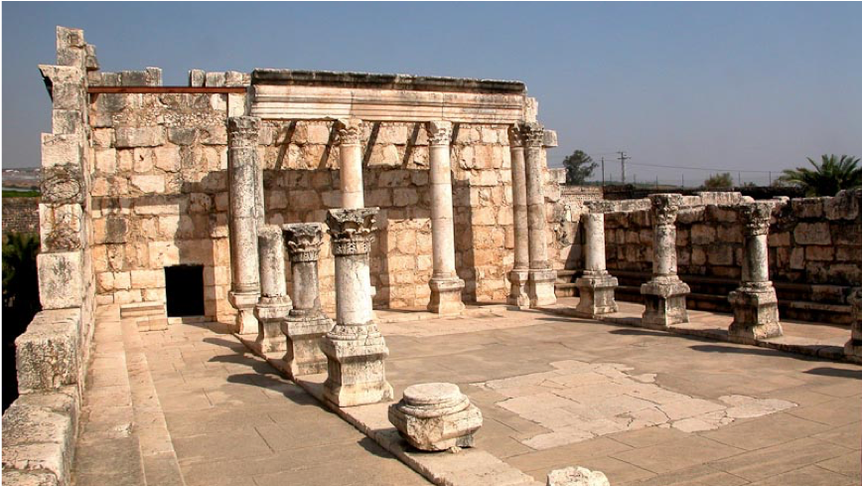
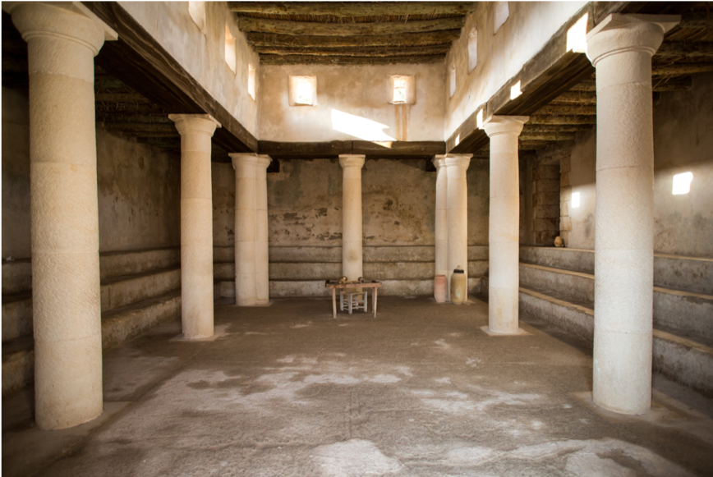
Where it Came From
The Synagogue
συναγογη “gather together”
System of meeting developed during Babylonian captivity and throughout first 3 centuries as designated meeting places for schools, hostels, court meetings, charity centers, and worship (Josephus Antiquities 14.214ff; 16.43)
Basic service Officers (minimum of 11 people)
Order of Service of Sabbath Synagogue

Slide 12
Where it Came From
The Synagogue
συναγογη “gather together”
System of meeting developed during Babylonian captivity and throughout first 3 centuries as designated meeting places for schools, hostels, court meetings, charity centers, and worship (Josephus Antiquities 14.214ff; 16.43)
Basic service Officers (minimum of 11 people)
Prayer sheliach tsibbuer ”messenger of the congregation”
Readers of the law (7 people in succession)
Reader of the prophets
Interpreter (for those who did not speak Hebrew)
Preacher (often selected from the congregation)
Order of Service of Sabbath Synagogue

Slide 13
Where it Came From
The Synagogue
συναγογη “gather together”
System of meeting developed during Babylonian captivity and throughout first 3 centuries as designated meeting places for schools, hostels, court meetings, charity centers, and worship (Josephus Antiquities 14.214ff; 16.43)
Basic service Officers (minimum of 11 people)
Order of Service of Sabbath Synagogue
Benedictions, Shema, Prayers, and Eulogies
Reading of the law
Reading of the prophets
Sermon
Benediction

Slide 14
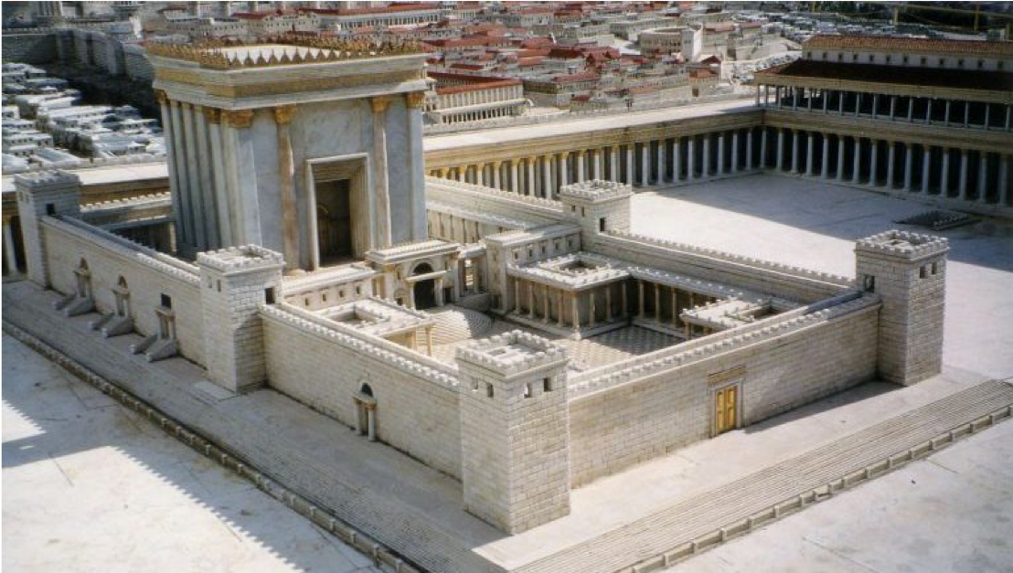
Where it Came From
The Temple
Sacrifices and rituals (liturgy/traditions) = Lord’s supper and rituals (see Leviticus)
The Didache

Slide 15
Where it Came From
The Temple
The Didache
“The Teaching” (of the twelve apostles)
Extremely early Christian document (approx. 90AD) with a summary of the teaching the apostles approved of and instructions on conducting ”sabbath” worship services.
Instructions included:
Baptism (ch 7)
Fasting and Prayer (ch 8)
The Lord’s Supper (ch 9)
Prayer after the Lord’s Supper (ch 10)
How to treat visiting teachers/prophets (ch 11)
How to treat visiting Christians (ch 12)
Providing the needs of teachers and prophets (ch 13)
Instructions on “the Lord’s Day” (ch 14)
Leadership (ch 15)

Slide 16
Where it Came From
The Didache, Chapter 14:
As for the day for the Lord, when you gather, break bread and have the good gift [I.e. Lord’s supper/communion] after confessing your transgressions; this is how your sacrifice is pure. But any having a quarrel with his friend may not come together with you, until they are reconciled, in order that you will not make the sacrifice common [unclean]. This is what was spoken by the Lord, “In every place and time offer to me a pure sacrifice. Because I am a great king, says the Lord, and my name is wonderful among the nations.””

Slide 17
Where it Came From
Pattern of Gathering as Exemplified in Acts 4:32ff; 11:26; 12; 14; 15; 20
Gathered in a house
The apostles and/or elders taught
Ate together
Prayed together
Collected money to meet needs of the poor
Progress of History
Early Church > Medieval Church > Protestant Church > Modern Church

Slide 18
Tradition vs. Prescription
All denominations practice traditions (liturgy)
Order of service
“Script” with which people are comfortable
Accepted songs
Length of service
All Christians have certain prescriptions for their gathering and daily life
E.g.: Teaching (Preaching?); Singing; Prayer; Confession; Giving charity; Communion; Loving/serving one another; quiet times
KING OF MY HEART SONG NEXT WEEK

