Slide 1
Revelation Pt 10
Millennial Kingdom Interpretations; Eternal State (Ch 20-22)
By Stephen Curto
For Homegroup
August 18, 2019

Slide 2
Our Outline
Overview/Outline of Book/"Things That are Seen" (Ch. 1)
"Things that Are" (Ch. 2-3)
After these Things: Heavenly Scene (Ch 4-5)
The Seal Judgments, 1st (((The 144,000 and The Multitude))) (6:1-8:5)
Trumpet Judgments 1-6 (Ch8-9)
2nd (((7 Thunders and Little Book; Two Witnesses))) 7th Trumpet Judgment (10:1-11:14)
3rd (((Israel’s Flight; Two Beasts; 5 scenes of hope))) (Ch. 12-14)
Bowl Judgments; 4th (((Babylon’s Fall))) (15:1-18)
Marriage Supper; 2nd Coming, Millennial Kingdom (Ch 19-20)
Millennial Kingdom (2nd pass) Eternal State (Ch. 21-22)

Slide 3
Context

Slide 4
Review
Revelation
16:12–16
Dragon
Beast
False
Prophet

Slide 5
Review
Revelation
19:11–16
Dragon
Beast
False
Prophet

Slide 6
Review
Revelation
19:17–18
Dragon
Beast
False
Prophet

Slide 7
Review
Revelation
19:19–20
Dragon
Beast
False
Prophet

Slide 8
Review
Revelation
19:21
Dragon

Slide 9
Review
Revelation
20:1–3
Dragon

Slide 10
Review
Revelation
20:4a

Slide 11
Review
Revelation
20:4b–6

Slide 12
Review
Revelation
20:7-8
Satan

Slide 13
Review
Revelation
20:9-10
Satan

Slide 14
Review

Slide 15
Outline
Millennial Kingdom (Ch 20)
Eternal State (Ch 21-22)

Slide 16
Interpretive Systems
Premillennialism
Christ’s return will be before (pre) a literal 1,000 year reign (Millennium)
Usually views Revelation ch 4ff as entirely future
“Historical Premillennialism” views the events in 4-19 as symbols of church/world history leading up to a future millennium
Amillennialism
Postmillennialism

Slide 17
Interpretive Systems
Premillennialism
Amillennialism
There is no literal millennium, but we are living in the non-literal millennium right now: the church age. The millennial kingdom is a purely spiritual one, and Christ’s return to earth is the consummation of the millennium.
Usually views ch 4-18 and 20:1-10 of Revelation as past tense (Preterism)
Postmillennialism

Slide 18
Interpretive Systems
Premillennialism
Amillennialism
Postmillennialism
Quite similar to amillennialism, but stipulating that the world will undergo a progressive Christianization (building the Kingdom on earth), which ushers in the return of Christ and the eternal state.
“We believe Scripture promises the advance and victory of Christ's Kingdom in this age, leading to the final judgement. Like leaven working through the dough till all is leavened. For He must reign until all His enemies are made a footstool for His feet, up to the last enemy, death.” Johnny Simmons (Postmil friend)

Slide 19
Interpretive Systems

Slide 20
Why the Differences?
Hermeneutical practices/priorities
Historical events

Slide 21
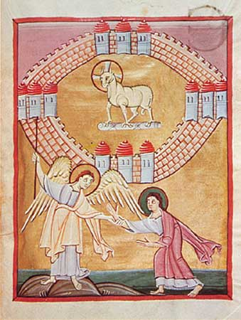
Why the Differences?
Hermeneutical practices/priorities
“Apocalyptic Literature” is often viewed as a separate genre which must be interpreted according to different hermeneutical principles
Many interpreters view the book of Revelation as “separate” from the canon instead of part of the singular story
Historical events

Slide 22
Why the Differences?
Hermeneutical practices/priorities
Historical events
Licentious Premill theology (300’s)
Augustine – “City of God” popularized Amillennialism as an alternative (400’s)
Middle Ages – development of Postmill theology with the evangelization of the European tribes (500-1500)
Return of Premill Theology with smaller late-reformation movements, strengthened by WWI and WWII decreasing Postmil popularity

Slide 24
Interpretive Systems

Slide 25
Eternal State (ch 21-22)

Slide 26
Eternal State (ch 21-22)
“Then I saw a new heaven and a new earth; for the first heaven and earth passed away, the sea is yet no longer.” (21:1)
“New” καινος kainos has wide semantic domain: ”unused,” “strange or noteworthy,” “not old” “refurbished”
νεος neos more narrowly means ”brand new” “just made”
καινος is used for the “new earth” and “new heaven” and “new Jerusalem”
What kind of a new heaven and earth does John see?

Slide 27
Eternal State (ch 21-22)
“And I saw the holy city, new Jerusalem, coming down out of heaven from God, made ready as a bride adorned for her husband.” (21:2)
Who is the bride?
“The tabernacle of God is among men and he will tabernacle among them, and they shall be His people, and God Himself will be among them” (21:3)
What part of the story should this bring to mind?
“He who overcomes will inherit these things” (21:7)

Slide 28
Eternal State (ch 21-22)
“Come I will show you the bride, the wife of the lamb” (21:9)
New Jerusalem: (21:10-23)
Coming from heaven (v10)
Brilliance like jasper (v11)
72 yard high walls, 12 pearl gates, names of tribes, 3 on each wall, guarded by angels (v12-13, 17, 21)
12 foundation stones, names of apostles (v14)
12,000x12,000 stadia cube (approx. 1500 miles) (v16)
City: gold; wall: jasper (v18)

Slide 29
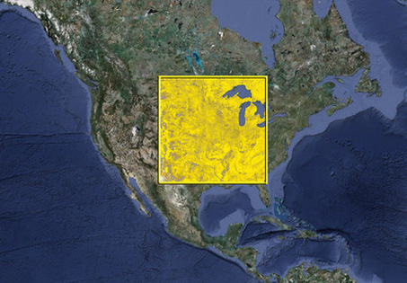

Slide 30
Eternal State (ch 21-22)
New Jerusalem: (21:10-23) (cont’d)
12 foundation stones = stones of garden, stones of ephod (Ex 28; Ezek 28:13; Gen 2:12)
No temple, sun, or moon because God is there (v 22-23)
Measuring of the temple (21:15)(cf. Ezek 40)
Different measurements?
“The nations will walk by its light, and the kings of the earth will bring their glory into it” (v24)
What is “it”?
Who are these kings and nations and where are they living?

Slide 31
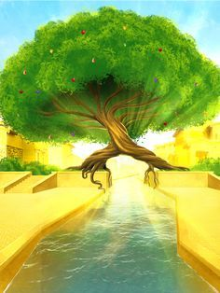
Eternal State (ch 21-22)
“Then he showed me a river of the water of life coming from the throne of God and of the lamb… tree of life yielding its fruit” (22:1-2)
Cf. “River of life” Ezek 47; “Tree of Life” Gen 3:22-24
“The leaves of the tree were for the healing of the nations.” (22:2)
What does this mean? (cf Gen 3:7; 8:11; Gen 22:18; Deut 32:43; Ps 86:9; 106; Is 11-12; 66; Zech 8:23)
“nations” ἐθνος ethnos often translated “gentiles”

Slide 32
Eternal State (ch 21-22)
“And behold, I am coming quickly. Blessed is he who heeds the words of the prophecy of this book.” (22:7)
“Do not [worship me] I am a fellow servant of yours and your brethren the prophets and those who heed the words of this book.” (22:9)
Are verses 22:11-12 surprising?
“Blessed are those who wash their robes so that they may have the right to…” (22:14)
Who washes their robes?

Slide 33
Eternal State (ch 21-22)
To what is verse 15 referring?
If anyone adds to or takes away from the words of the book of this prophecy, different results. What are they? (22:18-19)
“Yes I am coming quickly.” (22:20)

