Slide 1
Understanding the Will of God
Part 3: The Holy Spirit’s Role in the Will of God
By Stephen Curto
For Homegroup
Oct 27, 2019

Slide 2
Outline
Review
Works of The Holy Spirit in the New Testament (?)
The Holy Spirit In the Life of the Individual Christian
The Holy Spirit In the Life of the Corporate Body
The Holy Spirit’s Role in Discerning the Desire of God

Slide 3
Review
The desire of God through the Biblical Story: some changes; some constants.
Discerning the Desire of God: will not be vague impressions, but clear statements
The four questions for discerning the will of God:
Sinful?
Preach the gospel/spiritual life hindrance?
Responsibilities to family/employer/elders?
Sinful desire?

Slide 4
Works of The Holy Spirit in the New Testament (?)
Revelation: Rev 1:10
Filling (2 Types): (Type 1) Acts 2:4; 4:8 (Type 2) Eph 5:18
Indwelling: Rom 8:9
Sealing: Eph 1:13
Gifting: 1 Cor 12:1ff
Baptism: 1 Cor 12:13
Sanctifying: Eph 5:17

Slide 5
Defining Some Terms
“Led by the Spirit” (Rom 8:14)
“walk by the Spirit” (Gal 5:16)
“be filled with the Spirit” (Eph 5:18)
”Quench the Spirit” (1 Thess 5:19)
“Grieve the Spirit” (Eph 4:30)
“Fellowship of the Spirit” (Phil 2:1)

Slide 6
Defining Some Terms
Live in the freedom of the gospel (i.e. Love God and do as you please)
Refuse to believe that the OT prophecies will come to pass
Make the Spirit sad by hating your brother
Christians being together united by the gospel
“Led by the Spirit” (Rom 8:14)
“walk by the Spirit” (Gal 5:16)
“be filled with the Spirit” (Eph 5:18)
”Quench the Spirit” (1 Thess 5:19)
“Grieve the Spirit” (Eph 4:30)
“Fellowship of the Spirit” (Phil 2:1)

Slide 7
The Holy Spirit In the Life of the Individual Christian
Initially convicts of the condition of sin to bring about repentance and faith, thus allowing them to worship God in truth. (John 16:8; Phil 3:3; Titus 3:5; Rom 8:9)
Seals (acts as the down-payment of) the believer for resurrection. (Eph 1:13; 4:30; 2 Cor 1:22)
Temporarily empowers Christians to miraculously accomplish/reveal the desires of God for the encouragement/growth of the Church. (Acts 2; 4; 9; 10; 13; 19; 1 Cor 12)
Frees the Christian to walk apart from the law (Gal 3; 5; Phil 1:27)
Intercedes with Christ through our prayers (Rom 8:26)

Slide 8
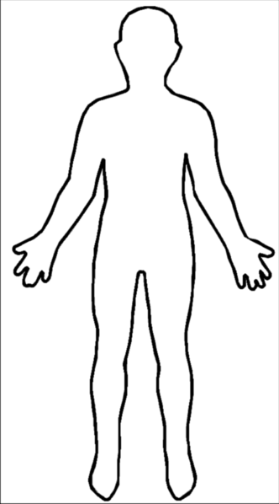
The Holy Spirit In the Life of the Corporate Body
Act as the body of Christ, thus housing the Holy Spirit and bring the individual believer into the presence of Christ and worship God. (1 Cor 6:17ff [Context 1 Cor 1-14]; Matt 18:20; Phil 3:3; Gospels)
Act as an encourager among Christians, as love and truth are used for the building up of the body. (1 Cor 12-14; Phil 2:1)

Slide 9
The Holy Spirit’s Role in Discerning the Desire of God
Because God can do whatever he wants to do, he may appear to you, e.g. Paul on road to Damascus, and communicate his desires directly.
Nowhere in Scripture does he communicate his desire via the Holy Spirit vaguely.
The conscience vs the Holy Spirit (Rom 2:15; 9:1; 13:5; 1 Cor 8:7-12; 10:25-29; 2 Cor 4:2; 5:11; 1 Tim 1:5, 19; 3:9; 4:2; Titus 1:15; Heb 9:9-14; 1 Pet 3:16-21)

Slide 10
“Counter” Passages
John 14:26 – To the Apostles
All Occurrences in Acts – Were either specific/clear, or acts of the Apostles who interacted with the Spirit in a unique way (cf. John 14:26)
1 Cor 2:10 – About the Apostles (cf. John 14:26)
1 Cor 3:16 – corporate, not individual
Phil 4:13 – the strength comes from knowledge of the gospel and fellowship of the saints

Slide 11
Walking Through 1 Corinthians
Main Holy Spirit passages: ch 6, chs 12-14
Context: Chs 1-14
The point of the book: “I’m an apostle, and Christ is in charge.”
1:1-4:17 – Purpose of the letter: Unity in Christ, while recognizing Paul’s authority
4:18-6:20 – Unity in Christ
7:1-11:22 – Paul’s Authority
11:23-12:31 – Unity in Christ
13:1-14:40 – Paul’s Authority
Ch 15 – Unity in Christ
Ch 16 – Paul’s Authority

