Slide 1
Understanding the Will of God
Part 1: Defining Terms
and Surveying the Text
By Stephen Curto
For Homegroup
Oct 13, 2019

Slide 2
Define “Will” and “Will of God”
Word Studies:
OT
NT

Slide 3
Define “Will” and “Will of God”
Word Studies:
OT
רָצוֹן ratson or חֵפֶץ hephetz “desire, favor, pleasure, good-pleasure, acceptable”
Old Testament rarely talks of “God’s will” instead usually opting for “God’s pleasure”
56 occurrences of ratson and 38 of hephetz
“face” pahney often used euphemistically to refer to God’s will or favor
NT

Slide 4
Define “Will” and “Will of God”
Word Studies:
OT
NT
θέλω thelo (verb) or θέλημα thelema (noun) “will, wish, want, desire”
208 occurrences of verb, 62 occurrences of noun
Used of both God and humans
A deliberative desire as opposed to an un-prompted urge
(In contrast with ἐπιθυμέω epithumeo “craving, desire, lust, wish, want”)

Slide 5
Define “Will” and “Will of God”
Sample Verses to Understand Semantic Domain: (OT)
Is 44:28a “It Is I who says of Cyrus, ‘He is my shepherd, and he will perform all of my desires.’”
Is 48:14 “[The Lord] will carry out his good pleasure on Babylon, and his arm will be against the Chaldeans.”
1 Sam 15:22 “Samuel said, ‘Has the Lord as much delight in burnt offerings and sacrifices as obeying the voice of the Lord?’”
Ps 40:8 “I delight to do Your will, o my God; Your law is within my heart.”
Ps 89:17 “For You are the glory of their strength, and by Your favor our horn is exalted.”
Lev 19:5 “Now when you offer a sacrifice of peace offerings to the Lord, you shall offer it so that you may be accepted.”

Slide 6
Define “Will” and “Will of God”
Sample Verses to Understand Semantic Domain: (NT)
James 4:15 “Instead you ought to say, ‘If the Lord wills, we will live and do this or that.’”
Eph 1:11 “… we have obtained an inheritance, having been predestined according to His purpose who works all things after the counsel of His will” (cf.1:1, 5, 9)
Gal 3:2 “This is the only thing I want to find out from you…”
1 Cor 7:39 “A wife is bound as long as her husband lives, but if her husband is dead, she is free to be married to whom she wishes, only in the Lord.”
Romans 7:15ff – the “I do not do what I want to do” passage.
Luke 20:46 “Beware of the scribes, who like to walk around in long robes…”
Luke 10:29 “But wishing to justify himself, he said to Jesus, ’And who is my neighbor?’”

Slide 7
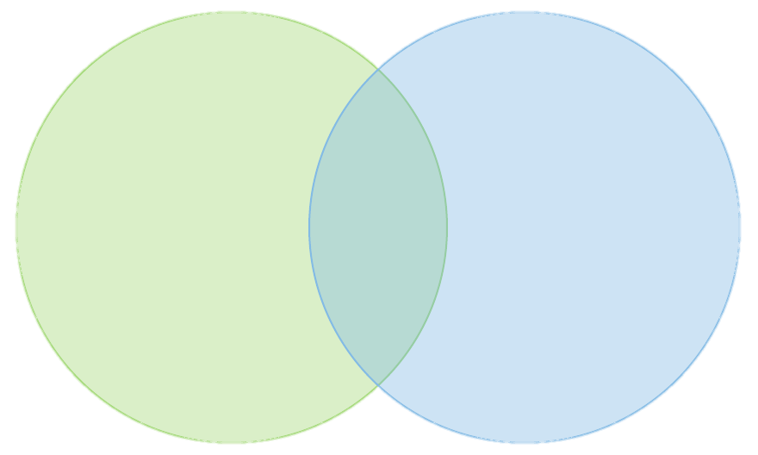
Define “Will” and “Will of God”
Logical Analysis:
How does God’s “desire” or “want” relate to reality?
How are God’s “good pleasures” motivated?
Compare and contrast human “desire” with God’s “desire.”

Slide 8
5 Biblical Passages for the NT Christian
1Thess 4:3-8
“This is the will of God: your sanctification”
1 Thess 5:16-18
“Rejoice always, pray without ceasing, in everything give thanks, for this is God’s will for you in Christ Jesus.”
Eph 5:15-21 (17)
“…Do not be foolish but understand what the will of the Lord is…”
1 Pet 2:13-20 (15)
“that by doing right you may silence the ignorance of foolish men.”
Col 1:9-10 (27; 4:12)
“to walk in a manner worthy of the Lord”

Slide 9
Our Definition
__________________________________________________________
__________________________________________________________
__________________________________________________________

