Slide 1
Apologetics Introduction
Worldviews, Why We Do Apologetics, Presuppositionalism vs Evidentialism, and Presuppositionalism and the Word of God
By Stephen Curto and Chris Bayack
For C3 Equip
Feb 9, 2020

Slide 2
Feb 9. “Introduction to Apologetics” Chris and Stephen
Feb 16. “Integrity and Reliability of Scripture” Stephen
Feb 23. “Foundations of Orthodoxy” Chris
Mar 1. “Aberrations in Christendom” Chris
Mar 8. “Mormonism and The Watchtower” Stephen
Mar 15. “Islam” Stephen
Mar 22. “The Problem of Evil, Part 1” Stephen
Mar 29. “The Problem of Evil, Part 2” Chris
Apr 5. “New Age/Spirituality” Open
Apr 12. Resurrection Sunday No Class
Apr 19. “Concerns Within Evangelicalism” Chris

Slide 3
Worldviews
What is a worldview?
“A worldview is simply the total of our beliefs about the world, the ‘big picture’ that directs our daily decisions and actions.”-Chuck Colson & Nancy Pearcey, How Now Shall We Live?
“A habituated way of seeing and doing.” -Paul Shockley
core beliefs that determine how we live
Who has a worldview?
What are the components of any worldview?

Slide 4
Worldviews
What is a worldview?
Who has a worldview?
Everyone. No exceptions.
What are the components of any worldview?
Notes:
Van Til Quote: We are trying appeal to the sense of diety in every man being created in the image of God (Find exact quote)
Course schedule on first page
5-10 minutes intro/roll/welcome
Chris Bio
Stephen Bio
Chris goes through schedule (Make Slide)
Stephen Does the main slides (25 min)
Chris does the word in support of presupp. ”The role of evidence in reinforcing the truth of the Bible” ( 15 min)
Download Registration list send to Chris Today

Slide 5
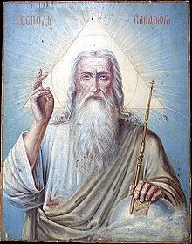
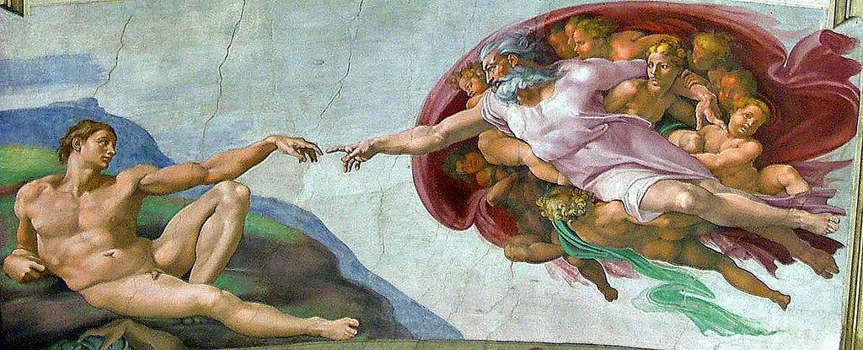
Worldviews
What is a worldview?
Who has a worldview?
What are the components of any worldview?
View of God, Truth, Reality, Knowledge, Ethics, Humanity, Evil

Slide 6
Why We Do Apologetics
Commands:
1 Peter 3:15-16
1 John 4:1
Examples:
Matt 22:29 (Jesus correcting error)
Matt 15:6-9 (Jesus refuting false teaching)
Acts 17:16-17 (Paul reasons with them)
Titus 1:9 (Paul refuted opposition to truth)
Phil 1:7 (Paul defended the gospel)
Rev 2:2 (“You have tested those who call themselves apostles”)

Slide 7
Why We Do Apologetics
To preach the gospel
To expose error & remove false obstacles
To defend Christian doctrine
To have fun

Slide 8
Presuppositionalism vs Evidentialism
Presuppositionalism
examples of a presupposition:
When did you buy the book?
You bought a book.
Julie’s cat is cute.
Julie has a cat.
You are late again.
You’ve been late before.
In the beginning God created the heavens and the earth.
God existed in the beginning.

Slide 9
Presuppositionalism vs Evidentialism
Presuppositionalism
“A neutral ground, criteria or standard that both believer and unbeliever can accept without compromising their system [does not exist].” - John Frame
“For the Christian, all standards of rationality, truth, knowledge, and reality, are based on the nature and character of the God in whom he believes, therefore he shares no ground with the unbeliever who accepts no God to establish such standards.” – Stephen Curto
Switzerland Does Not Exist.

Slide 10
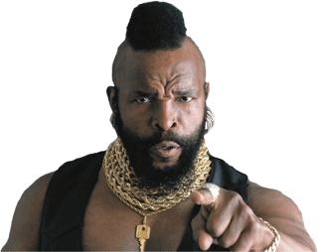
Presuppositionalism vs Evidentialism
Presuppositionalism
Romans 1:18-23
Jude 3
1 Corinthians 1:18-25
Leading Presuppositional Apologists:
Cornelius Van Til, John Frame, Vern Poythress, James White, Abraham Kuyper

Slide 11
Presuppositionalism vs Evidentialism
Evidentialism (or Classical/Traditional Apologetics)
the Christian should argue in an unbiased, neutral, way that makes no religious assumptions
The Christian should argue from criteria the unbeliever accepts (logic, facts, experience, reason)
The Bible is not used as evidence until after it has been “proved” reliable

Slide 12
Presuppositionalism vs Evidentialism
Evidentialism (or Classical/Traditional Apologetics)
Leading Classical Apologists
Justin Martyr, Thomas Aquinas, Norman Geisler, Ravi Zacharias, William Lane Craig, C. S. Lewis

Slide 13
Some Helpful Books
“Apologetics: A Justification of Christian Belief” by John Frame
“Christian Apologetics” by Cornelius Van Til
“Christian Apologetics” by Douglas Groothuis

Slide 14
Presuppositionalism and the Word of God
Jonah 2:9, “Salvation is from the Lord.”
If salvation is solely of God, then God has given us everything necessary to bring about that salvation.
Testimony of John 6
Verse 37
Verse 44
Verse 63
Evidence alone can never breathe spiritual life into a dead man.
God’s Word always accomplishes what He sends it forth to do.

Slide 15
Presuppositionalism and the Word of God
Isaiah 55:10-11, “For as the rain and the snow come down from heaven, and do not return there without watering the earth and making it bear and sprout, and furnishing seed to the sower and bread to the eater; so will My word be which goes forth from My mouth; it will not return to Me empty, without accomplishing what I desire, and without succeeding in the matter for which I sent it.”

Slide 16
Presuppositionalism and the Word of God
Negatively—Acts 13:46
Positively—Acts 13:48
Biblical evidence is consistent with the primacy of Scripture.

Slide 17
Presuppositionalism and the Word of God
Summary:
No amount of reasoning and debate by itself can bring the dead to life. It is the Spirit of God working through the Word of God that affects the salvation of God. Therefore as the believer is skilled in the Word of God, he is sufficiently equipped to reach the lost and defend the faith.

Slide 18
Presuppositionalism and the Word of God
Summary:
“Man’s mind is derivative. As such it is naturally in contact with God’s revelation. It is surrounded by nothing but revelation. It is itself inherently revelational. It cannot naturally be conscious of itself without being conscious of its creatureliness. For man self-consciousness presupposes God-consciousness. Calvin speaks of this as man’s inescapable sense of deity.” Cornelius Van Til, The Defense of The Faith, 113.

