Slide 1
Foundations of Orthodoxy
By Chris Bayack
For C3 Apologetics
February 23, 2020

Slide 2
Outline
The Nature of God
The Nature of Christ
Christ’s Nature - Overview
Christ’s Titles
Spirit of Antichrist
Other Truths about Christ
The Nature of Man
The Nature of the Gospel

Slide 3
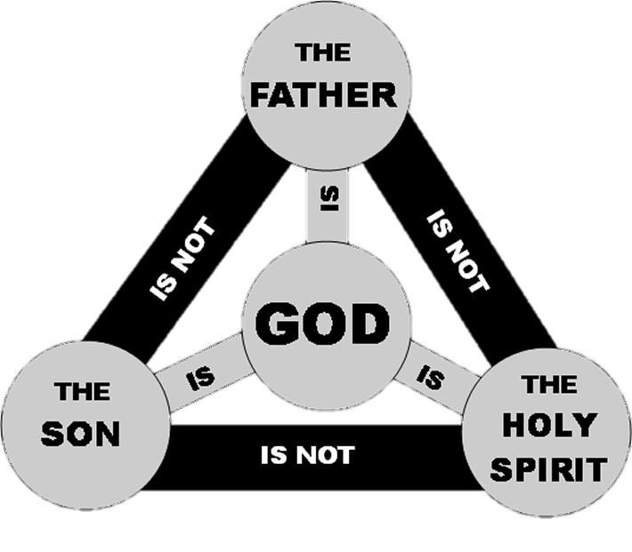
I. The Nature of God
God is one Being eternally manifest in three Persons (the Trinity).
“In the beginning God (Elohim) created the heavens and the earth” (Genesis 1:1).
“Hear, O Israel! The Lord is our God (Elohim), the Lord is one!” (Deuteronomy 6:4).

Slide 4
I. The Nature of God
The Father is God
“Grace to you from God our Father and the Lord Jesus Christ” (Romans 1:7).
The Son is God
“In the beginning was the Word, and the Word was with God, and the Word was God…And the Word became flesh and dwelt among us” (John 1:1,14).
The Holy Spirit is God
“But Peter said, ‘Ananias, why has Satan filled your heart to lie to the Holy Spirit…You have not lied to men but to God’” (Acts 5:3-4).

Slide 5
II. The Nature of Christ - Overview
Jesus Christ is fully God and fully Man.
“Jesus” is His human name and translates from the OT name “Joshua” meaning “the Lord saves.”
“Christ” is from the Greek “Christos” and means “Messiah.”

Slide 6
II. The Nature of Christ - Overview
Jesus Christ is fully God.
“Truly, truly, I say to you, before Abraham was born, I am” (John 8:58).
Jesus Christ is fully Man.
“What was from the beginning, what we have heard, what we have seen with our eyes, what we have looked at and touched with our hands, concerning the Word of Life” (1 John 1:1).

Slide 7
II. The Nature of Christ - Titles
Son of God—emphasizes His deity.
“For this reason therefore the Jews were seeking all the more to kill Him, because He not only was breaking the Sabbath, but also was calling God His own Father, making Himself equal with God” (John 5:18).

Slide 8
II. The Nature of Christ - Titles
Son of Man—emphasizes both humanity and deity with a particular emphasis on deity.
13“I kept looking in the night visions, and behold, with the clouds of heaven One like a Son of Man was coming, and He came up to the Ancient of Days and was presented before Him. 14And to Him was given dominion, glory and a kingdom, that all the peoples, nations and men of every language might serve Him. His dominion is an everlasting dominion which will not pass away; and His kingdom is one which will not be destroyed” (Daniel 7:13-14).

Slide 9
II. The Nature of Christ - Titles
Son of Man—emphasizes both humanity and deity with a particular emphasis on deity.
7“‘Why does this man speak that way? He is blaspheming; who can forgive sins but God alone?’…10‘But so that you may know that the Son of Man has authority on earth to forgive sins’—He said to the paralytic, 11‘I say to you, get up, pick up your pallet and go home’” (Mark 2:7, 10).

Slide 10
II. The Nature of Christ - Titles
Son of David—emphasizes His humanity.
“The record of the genealogy of Jesus the Messiah, the son of David, the son of Abraham” (Matthew 1:1).
Summary—Jesus Christ is fully God and fully Man with two natures in one person.

Slide 11
II. The Nature of Christ - Antichrist
The denial of Jesus Christ in either His humanity or deity is the spirit of antichrist.
23“This is His commandment, that we believe in the name of His Son Jesus Christ…1Beloved, do not believe every spirit, but test the spirits to see whether they are from God, because many false prophets have gone out into the world. 2By this you know the Spirit of God: every spirit that confesses that Jesus Christ has come in the flesh is from God; 3and every spirit that does not confess Jesus is not from God; this is the spirit of the antichrist, of which you have heard that it is coming, and now it is already in the world” (1 John 3:23, 4:1-3).

Slide 12
II. The Nature of Christ - Antichrist
“Antichrist” comes from the Greek words anti meaning “instead of” and christos meaning “Christ.”
Antichrist is “one who assuming the guise of Christ opposes Christ” (G. Abbott-Smith, A Manual Greek Lexicon of the New Testament, s.v. antichristos).

Slide 13
II. The Nature of Christ - Other
He was virgin-born.
“‘Behold, the virgin shall be with child and shall bear a Son, and they shall call His name Immanuel,’ which translated means, ‘God with us’” (Matthew 1:23).
He was sinless.
“He made Him who knew no sin to be sin on our behalf, so that we might become the righteousness of God in Him” (2 Corinthians 5:21).

Slide 14
II. The Nature of Christ - Other
He died physically.
30“Therefore when Jesus had received the sour wine, He said, ‘It is finished!’ And He bowed His head and gave up His spirit…34But one of the soldiers pierced His side with a spear, and immediately blood and water came out” (John 19:30, 34)
He rose bodily.
“See My hands and My feet, that it is I Myself; touch Me and see, for a spirit does not have flesh and bones as you see that I have” (Luke 24:39).

Slide 15
III. The Nature of Man
All men are equally created in the image of God.
26“Then God said, ‘Let Us make man in Our image, according to Our likeness; and let them rule over the fish of the sea and over the birds of the sky and over the cattle and over all the earth, and over every creeping thing that creeps on the earth.’ 27God created man in His own image, in the image of God He created him; male and female He created them” (Genesis 1:26-27).

Slide 16
III. The Nature of Man
All men are equally fallen and in need of a Savior.
10“THERE IS NONE RIGHTEOUS, NOT EVEN ONE; 11THERE IS NONE WHO UNDERSTANDS, THERE IS NONE WHO SEEKS FOR GOD; 12ALL HAVE TURNED ASIDE, TOGETHER THEY HAVE BECOME USELESS; THERE IS NONE WHO DOES GOOD, THERE IS NOT EVEN ONE… 23for all have sinned and fall short of the glory of God” (Romans 3:10-12, 23).

Slide 17
IV. The Nature of the Gospel
Salvation is solely of God and not at all of man. Salvation is the free gift of God that comes by faith alone in Jesus Christ.
1“Now I make known to you, brethren, the gospel which I preached to you…3that Christ died for our sins according to the Scriptures, 4and that He was buried, and that He was raised on the third day according to the Scriptures” (1 Corinthians 15:1, 3-4).
“I am the way, and the truth, and the life; no one comes to the Father but through Me” (John 14:6).

Slide 18
IV. The Nature of The Gospel
Salvation is solely of God and not at all of man. Salvation is the free gift of God that comes by faith alone in Jesus Christ.
“And there is salvation in no one else; for there is no other name under heaven that has been given among men by which we must be saved” (Acts 4:12).
8“For by grace you have been saved through faith; and that not of yourselves, it is the gift of God; 9not as a result of works, so that no one may boast” (Ephesians 2:8-9).

