Slide 1
Lesson 1: Introduction and Alphabet
By Stephen Curto
For Greek 2020
Feb 25, 2020

Slide 2
Outline
Introductory Matters/Syllabus
General Tips and Tricks
Vocabulary
Alphabet
Homework

Slide 3
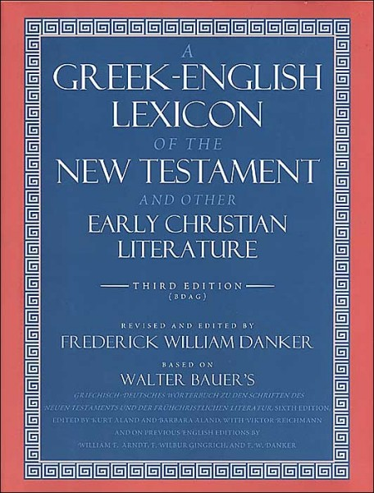
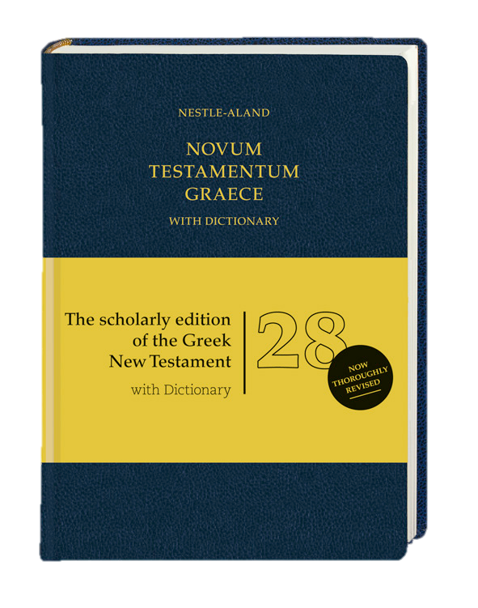
Introductory Matters
Suggested Supplements
Bauer-Danker-Arndt-Gingrich. A Greek-English Lexicon of the New Testament and Other Early Christian Literature. 3rd ed., 2000. [BDAG] ISBN: 9780226039336
Aland, Kurt, et al. Novum Testamentum Graece. 28th edition, edited by Holger Strutwolf, et al. Stuttgart: Deutsche Bibelgesellschaft, 2012. Abbreviated as NA28. Includes Greek- English dictionary by Barclay Newman. ISBN: 9783438051608
Braun, Frank. English Grammar for Language Students. Eugene, OR: Wipf and Stock, 2013. ISBN: 9781620328743

Slide 4
Introductory Matters
Class Structure:
60 minute class periods, divided as follows:
10 minute review quiz
15 minute review of homework
5 minute break
20 minute lesson on new material
10 minute Q&A troubleshoot

Slide 5
Introductory Matters

Slide 6
General Tips and Tricks
15 minutes a day
View Greek study as a form of worship
Take notes in class BY HAND
Do not fear “The Fog”
Anki http://ankisrs.net/
Color coded flash cards
http://billmounce.com

Slide 7
Vocabulary
Lexicon – a dictionary
Lexical form – the form of a word that appears in a dictionary
Koine – 1st century common Greek. The kind of Greek you’re learning.
Transliteration – putting the Greek sounds into English letters (phonetic equivalence)
Translation – changing the Greek word to the proper English word (meaning equivalence)

Slide 8
Alphabet Pages 9-10
Α α
Β β
Γ γ
Δ δ
Ε ε
Ζ ζ
Η η
Θ θ
Ι ι
Κ κ
Λ λ
Μ μ
Ν ν
Ξ ξ
Ο ο
Π π
Ρ ρ
Σ σ, ς
Τ τ
Υ υ
Φ φ
Χ χ
Ψ ψ
Ω ω

Slide 9
Alphabet
Α α alpha - a as in father
Β β beta - b as in Bible
Γ γ gamma - g as in gone
Δ δ delta - d as in dog

Slide 10
Alphabet
Ε ε epsilon - e as in met
Ζ ζ zeta - z as in daze
Η η eta - e as in obey
Θ θ theta - th as in thing

Slide 11
Alphabet
Ι ι iota - i as in intrigue
Κ κ kappa - k as in kitchen
Λ λ lambda - l as in law
Μ μ mu - m as in mother

Slide 12
Alphabet
Ν ν nu - n as in new
Ξ ξ xi - x as in axiom
Ο ο omicron - o as in not
Π π pi - p as in peach

Slide 13
Alphabet
Ρ ρ rho - r as in rod
Σ σ, ς sigma - s as in study
Τ τ tau - t as in talk
Υ υ upsilon - u as in “kewl”

Slide 14
Alphabet
Φ φ phi - ph as in phone
Χ χ chi - ch as in Loch
Ψ ψ psi - ps as in lips
Ω ω omega - o as in tone

Slide 15
Alphabet
Tricky Letters:
Η η - the capital looks like an “h”, but η is a vowel
Μ μ - the lower case looks like a “u”, but μ a consonant
Ν ν - the lower case looks like a “v”
Ππ/Ρρ - rho looks like an English “p”
Χ χ - looks like an “x” but ξ makes that sound
Ω ω - the lower case looks like a “w”

Slide 16
Alphabet
Vowels:
α, ε, η, ι, ο, υ, ω
Double Letter Transliterations:
θ, φ, χ, ψ, ξ

Slide 17
Homework
The Alphabet. Know every letter (Upper and lower case) and the sound it makes.

