Slide 1
Feb 9. “Introduction to Apologetics” Chris and Stephen
Feb 16. “Integrity and Reliability of Scripture” Stephen
Feb 23. “Foundations of Orthodoxy” Chris
Mar 1. “Aberrations in Christendom” Chris
Mar 8. “Mormonism and The Watchtower” Stephen
Mar 15. “Islam” Stephen
Mar 22. “The Problem of Evil, Part 1” Stephen
Mar 29. “The Problem of Evil, Part 2” Chris
Apr 5. “The Issue of Origins” Chris
Apr 12. Resurrection Sunday No Class
Apr 19. “Concerns Within Evangelicalism” Chris

Slide 2
The Reliability of the Bible
Basics of Orthodox Bibliology and Evidence For Reliability
By Stephen Curto
For C3 Apologetics
February 16, 2020

Slide 3
Outline
Basics of Orthodox Bibliology
Inspiration
Inerrancy
The Story
Evidence for Reliability
Internal
External
Common Criticisms

Slide 4
Basics of Orthodox Bibliology
Inspiration - Verbal Plenary Inspiration
Verbal – the specific words
are inspired (1 Cor 2:2-13)
Plenary – all of the words are inspired (2 Tim 3:16-17)
Inspiration – God breathed the words out (2 Tim 3:16-17)
Greek: θεόπνευστος theopneustos
theos “God”; pneuma “Breath/Spirit”

Slide 5
Basics of Orthodox Bibliology
Inerrancy
“The Scriptures have never erred” –Luther, Luther’s Works, XV, 1481.
“the inerrancy of the Bible means simply that the Bible tells the truth.” –Ryrie, Basic Theology, 81.
“The every word in the original manuscripts is the true word of God.” - Curto
The Chicago Statement 1978
“Holy Scripture, being God’s own Word, written by men prepared and superintended by His Spirit, is of infallible divine authority in all matters upon which it touches”

Slide 6
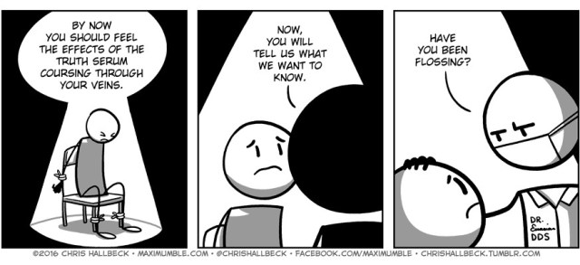
Basics of Orthodox Bibliology
Inerrancy

Slide 7
Basics of Orthodox Bibliology
The Story
The Bible is a story. It has 2 overall points:
To lay out the plan of creation, fall, redemption, and resurrection
To teach about and glorify the God enacting that plan
2 Tim 3:15 “Able to make you wise unto salvation”
Romans 15:4 “was written for our instruction… that we might have hope”

Slide 8
Basics of Orthodox Bibliology
It contains many genres
E.g. narrative, poetry, proverb, song, census data, genealogical record, legal documents, letters
It spans all of human history
Our time takes place in the middle of this story. “Biblical times” is all times!

Slide 9
Evidence for Reliability
Internal
Scriptures
2 Timothy 3:13-17 (Purpose, ability, and source of Scripture)
John 10:34-35; Matt 5:17-18 (Enduring Authority of Scripture)
2 Peter 3:15-16 (New Testament Authority as Scripture)
John 5:37-47; Luke 24:13-27 (The Testimony of Scripture)
Fulfillment of Bible Prophecy

Slide 10
Evidence for Reliability
External
Cumulative uniqueness suggests divine authorship
Unique in Continuity
Written over 1,500 years, by 40+ authors, on 3 continents, in 3 languages, in a variety of genres, with 1 continuous story
Unique in Circulation
Unique in Translation
Translated into 2,200 languages/dialects
Unique in Survival

Slide 13
Evidence for Reliability
Common Criticisms
The Bible is full of miracles.
The miraculous by definition is unique. This adds to the case, not subtract from it.
The Bible isn’t historically accurate.
There is virtually no archaeological evidence which directly refutes the Bible’s account of history. At best an argument from silence.
The Bible has little to no archaeological support.
This simply isn’t true. E.g. Biblical Archaeology Review magazine
There are two different Gods in the Bible. Wrathful OT; Loving NT.
This simply isn’t true. Ex 33:19; Revelation 5-20.

